Slide 1
About Eddie jackson
IT133-02: Software Applications Created: 10/15/2012

Slide 2
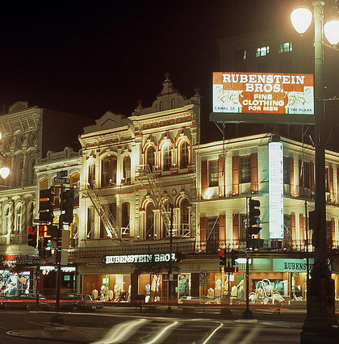
Birthplace
New Orleans - August 5th 1974
Earliest memories are happy
Moved around quite a bit
Ended up in Florida
Went through adoption

Slide 3
Humble Beginnings
Westville, FL
The Farm days on 19 acres
The animals
Daily chores
Amateur beekeeper
Father a pastor
Playing piano in church

Slide 4
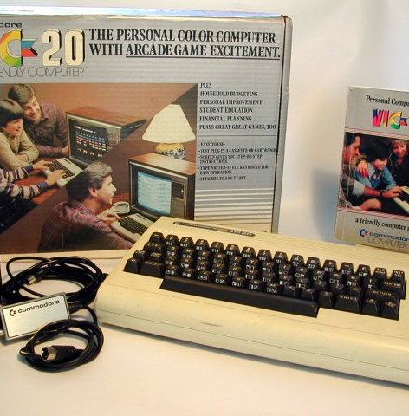
Childhood Hobbies
Playing piano of course
Playing with the Atari 2600
Electronic radio shack project kits
Electronic repair
I receive my first computer, VIC-20

Slide 5
School & Activities
Bonifay Elementary
Math Star Program
Gifted Program for 3 years
Skipped 5th & 8th grades
Holmes County High School
Army ROTC
Honor Club
Graduated High Honors

Slide 6
IT Training & Certification
Certifications from Vendors
Microsoft
CompTIA
Cisco
EC-Council
HP
ExecuTrain
CBTNuggets

Slide 7
Occupation: My Career
AMI, INC – first Corporate job
Healthcare
Ormond Beach Hospital
Daytona Beach Hospital
Doctor Offices
Kaplan University
Desktop Administrator
Software Packaging Engineer/Dev.

Slide 8
Please Contact Me
Email: mrnettek2000@yahoo.com
AIM: MrNetTek
Website: http://eddiejackson.net

