Slide 1
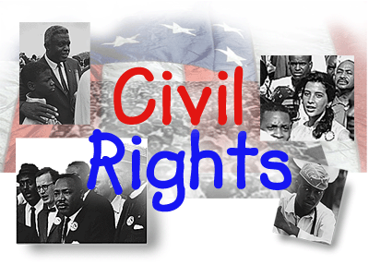

Civil Right Progress
Notes:
The Civil Rights movement, led by the great Martin Luther King Jr., made significant progress in the way of human rights by advocating that all men are created equal. He dreamed of a day when sons of past slave owners could sit down at the table of brotherhood…that African-Americans could be judged by the content of their character and not the color of their skin.

Slide 2
Thesis
Progress in Civil Rights has been made in the community since the Civil Rights era of the 1960s; however there is room for improvement.
Notes:
Much progress has been made in the way of Civil Rights. There are many changes that Martin Luther King Jr. would be very proud about. On the flip side there is definitely room for improvement. The slides here within will show both what we are right with civil rights and equality and what we could be doing better.

Slide 3
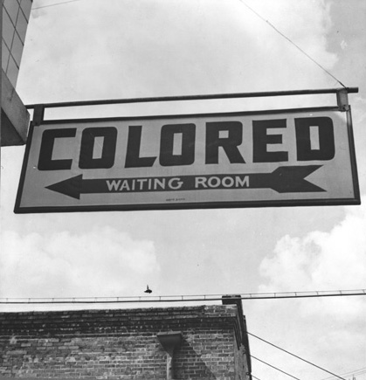
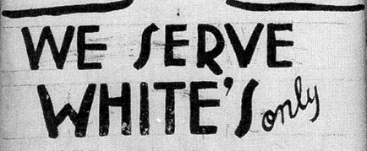
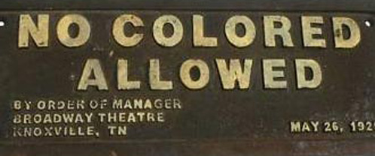

Past signs of segregation.
Notes:
These were some of the physical signs of segregation before the Civil Rights movement. These signs were meant to be a visual division of the races as it were. However, it was far worse than just these signs. The African-American community was literally looked down upon by the general (white) society, which in turn affected jobs, education, health and medical services, as well as grocery and convenience stores that were available to them.

Slide 4
Pictures from my community
Things we are doing right…

Slide 5
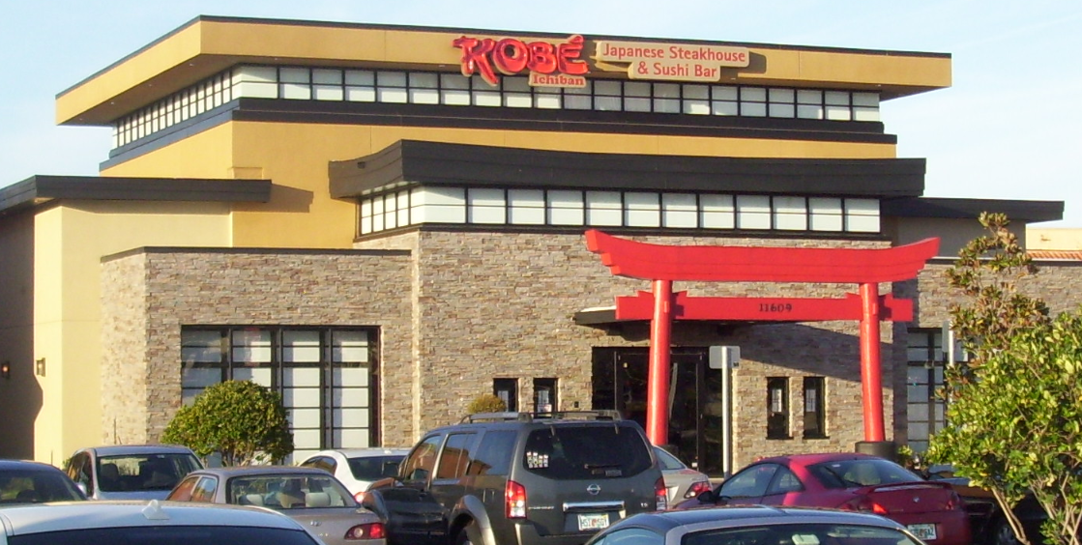
Restaurants open to everyone
Notes:
Martin Luther King Jr. struggled to have the signs of segregation removed…and as you can see here, there are no signs saying who can and who cannot come in and dine. All races of people are welcome.

Slide 6

Convenience stores open to all
Notes:
There are convenience stores open around the clock to all races of people. There are no more signs that say we don’t serve you…or to use a back entrance.

Slide 7
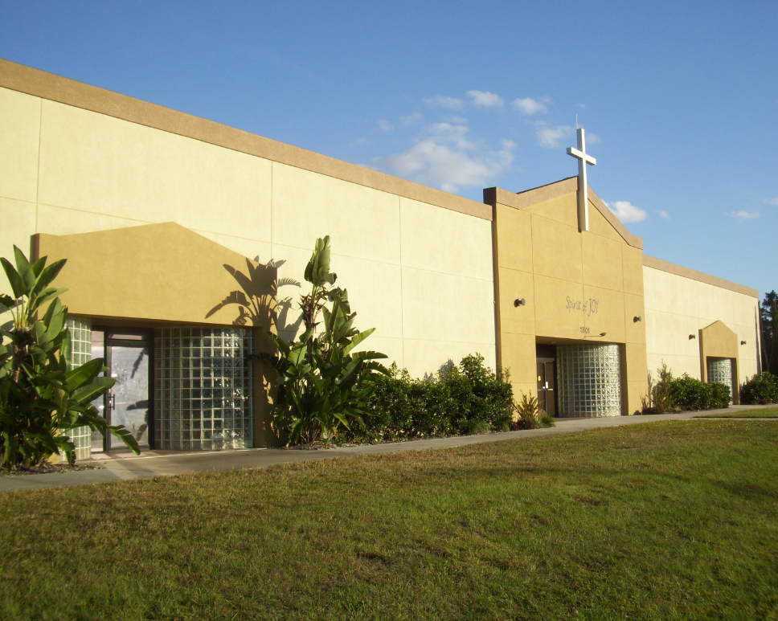
Places of worship open to all
Notes:
Another picture that would make MLK Jr. smile. This is a place of worship where any person of any race or of any color may attend. Before the Civil Rights movement, segregation was so overbearing that African-Americans were required to have their own churches.

Slide 8
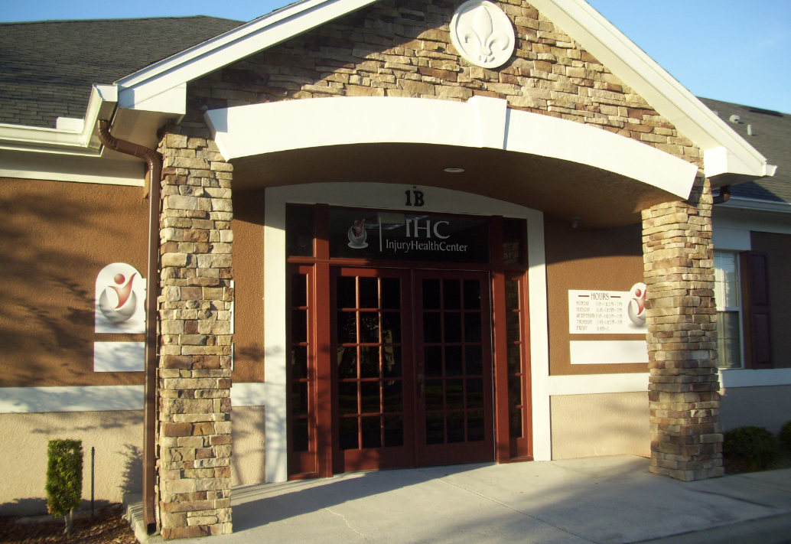
Family Health open to everyone
Notes:
No matter where you are from or what color your skin is, you can be sure that general health facilities like these will be available to all races of people.

Slide 9
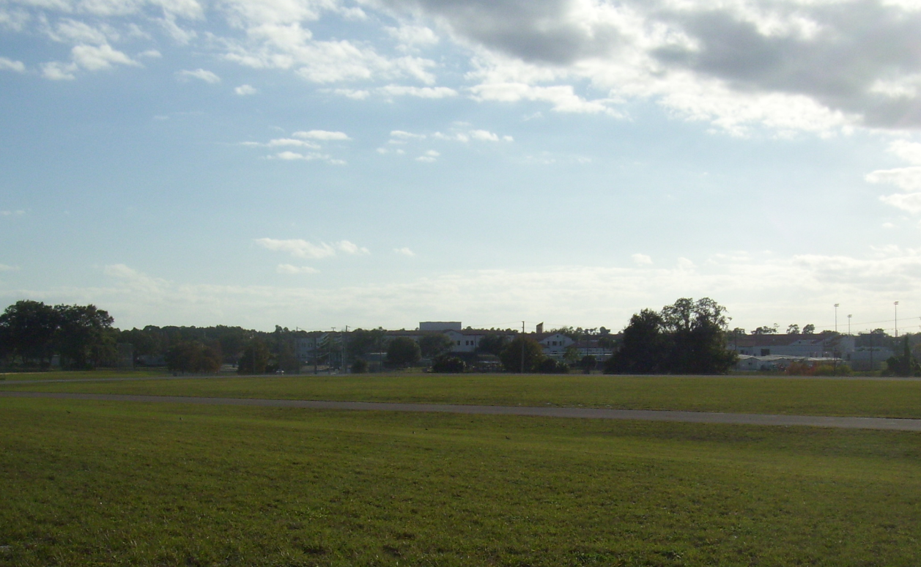
School’s Track and Field
Notes:
This is something else that MLK Jr. would smile about. This is a local high school’s track and field where all races of children train and compete together. Martin Luther King Jr. fought to desegregate schools.

Slide 10
Pictures from my community
Things we could do better…

Slide 11
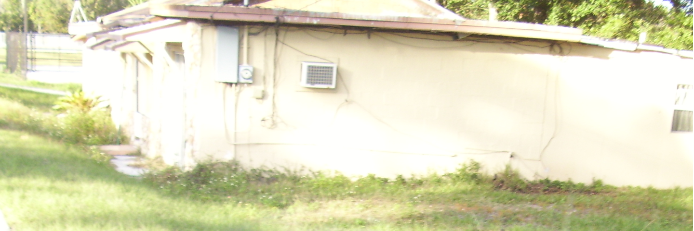
Poor neighborhoods
Notes:
There are many poor neighborhoods in my area where the majority of people living there are minorities (mostly African-American). They are living in substandard conditions.

Slide 12
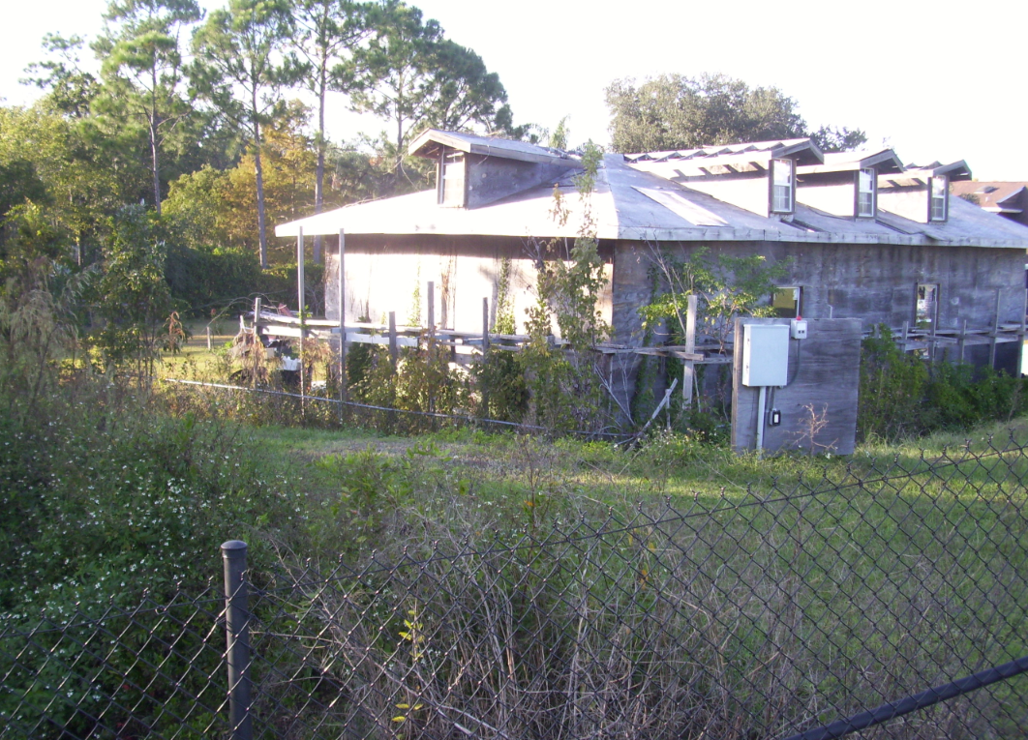
Some areas are very poor
Notes:
Some areas are bad enough to be condemned.

Slide 13
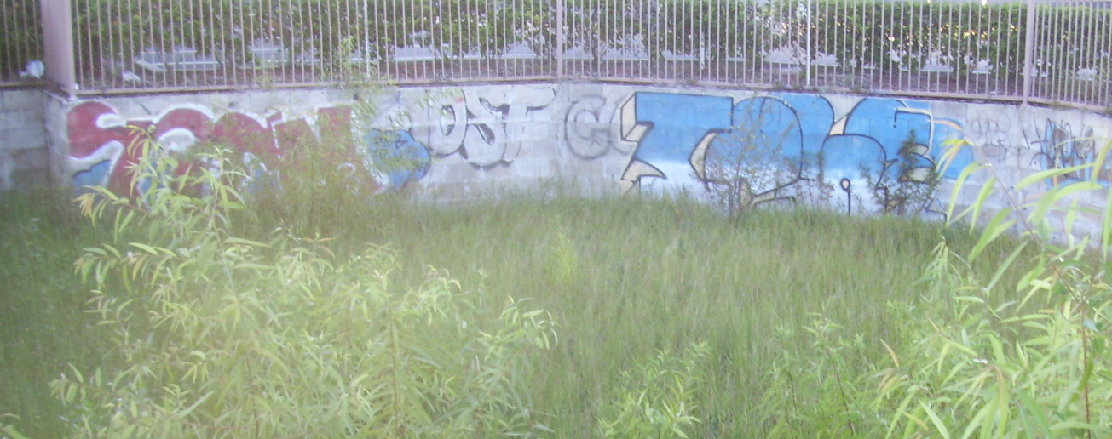
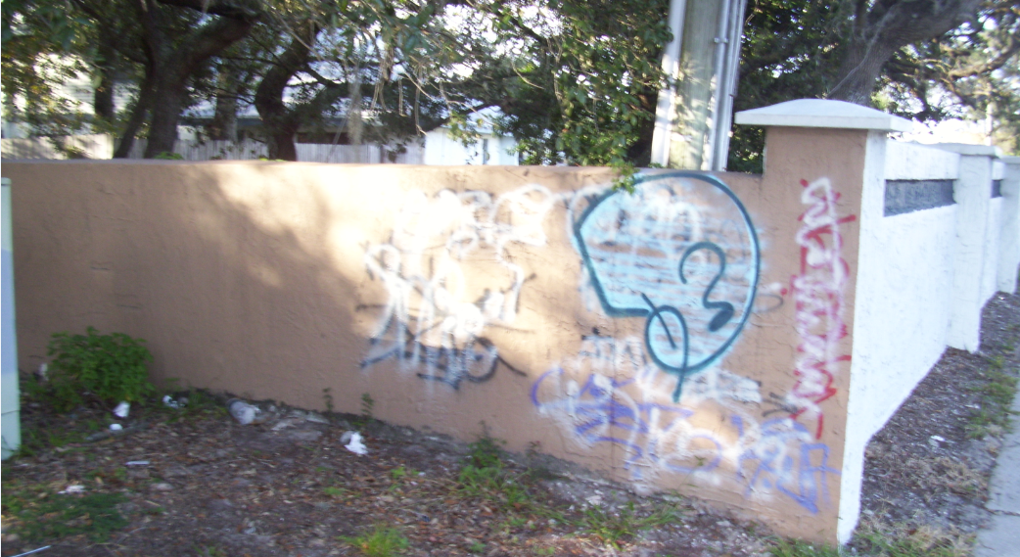
Areas riddled with graffiti
Notes:
Some things MLK Jr. would not be very happy about is that many of the African-American communities are run down, and there is a noticeable lack of county and state effort in cleaning up the areas.

Slide 14
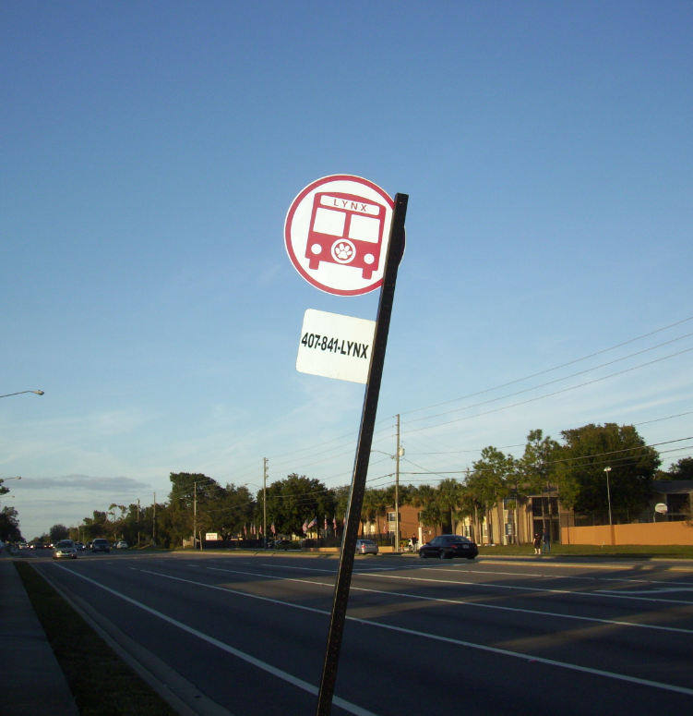
Transit System for the poor
Notes:
What I have excluded from this photo are the people waiting for the bus. In my community, the majority of people who have to take the bus are African-Americans and Spanish-Americans. There is a noticeable inequality and perhaps even less opportunity offered to the minorities in my area. MLK Jr. would surely say this needs improvement.

Slide 15
Pictures from my community
But things are always getting better…

Slide 16
Major Construction
Notes:
The area is getting better. There is major construction going on everywhere. This picture is right in the middle of my community. MLK Jr. always sought after progress…and building up the poorer communities would have been right up his alley.

Slide 17
References
Hasham (August 24th, 2011). Women Problem Information. Retrieved (11/13/2011), from
http://www.women-problem.com/wp-content/uploads/2011/08/civil-Rights.gif
Heller, Steven (n.d.). Jim Crow Had to Go.
Retrieved (11/13/2011), from http://imprint.printmag.com/daily-heller/jim-crow-had-to-go/ (signs)
Jackson, Eddie (11/13/2011). All community pictures.

Slide 18
Bonus picture
I just thought you would like this…

Slide 19
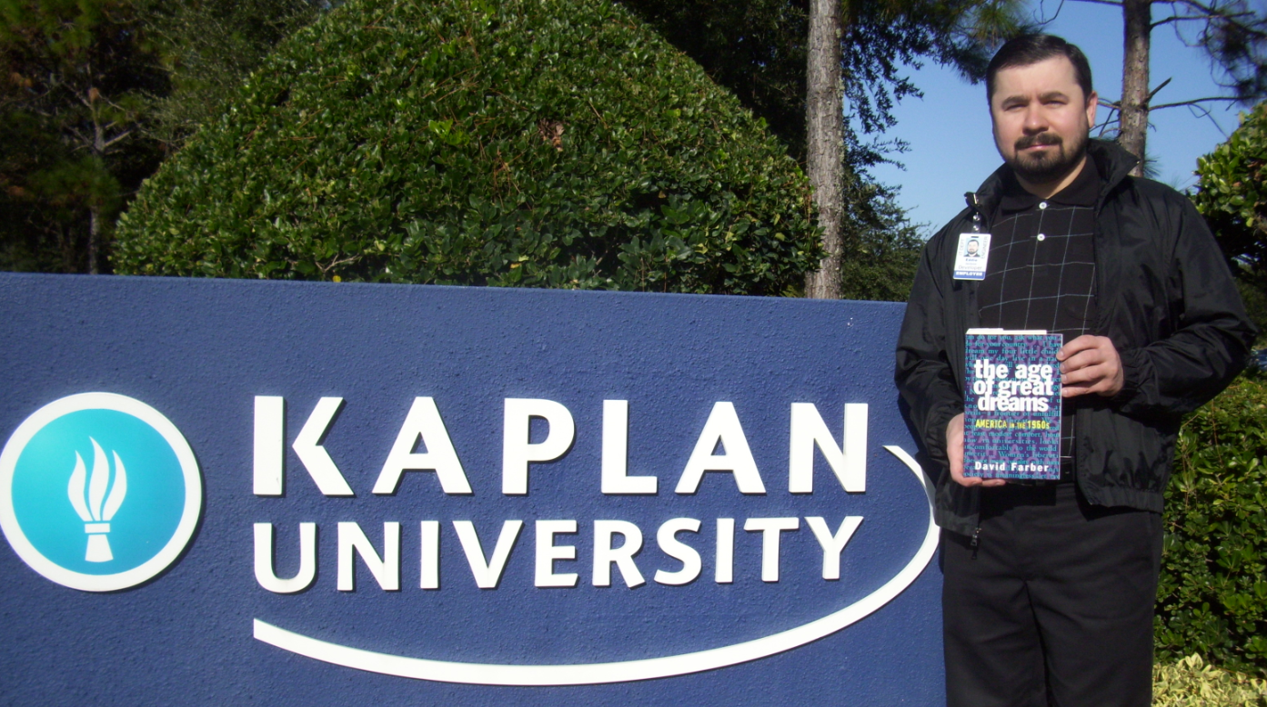
The age of great dreams
Notes:
“Intelligence plus character-that is the goal of true education.” ― Marin Luther King Jr.

