Slide 1
Microsoft Bitlocker
EDDIE JACKSON Kaplan University
IT599-01 IT Masters Project
Rhonda Chicone, PhD. august 4, 2015

Slide 2
Why did we choose Bitlocker?
Protects data on hard drive
Prevents offline attacks
Easier disk disposal
Already exists on the operating system
Peace of mind

Slide 3
Why didn’t we purchase a solution?
MBAM/MDOP - $10 per seat for Microsoft Management Solution - $50-$150 per seat for a 3rd party solution - Requires new server systems VS.
In-house Solution - Less than a $1 per seat, mostly due to administrative costs - Use existing servers - Lower TCO - Higher ROI

Slide 4
stakeholders
Title | Description
CFO | Chief Financial Officer, in charge of company finances
CIO | Chief Information Officer, in charge of company technology
Change Management Team | Authorizes changes to enterprise systems
Senior Software Developer | Responsible for software development
IT Manager | Communicates directly to IT staff
IT Team Leader | Performs training to IT staff

Slide 5
Budget
Budget Item | Description | Cost
Code development | Reporting and TPM Management solutions must be developed in-house | $3,500
Training | Documentation must be created and staff trained | $2,000
20 x Computers | Twenty computers have been allocated to replace non-working TPM chips: Each computer costs $1,000. | $20,000
Technical Support | $25 per hour, with a breakdown of 25 hours * $25 * 3 sites | $1,875
Miscellaneous Costs | Costs include support for Active Directory, Network computers, and the Bitlocker solution. | $2,625
 | Total cost | $30,000

Slide 6
the In-house solution
Developing low cost, easy-to-use tools
These tools include monitoring, management, and compliance solutions
Specifically, the tools are to be used by - admins - technicians - helpdesk - compliance

Slide 7
Risk analysis
Risk | Description | Mitigation | Role
Failed key import into LANDesk | The recovery key does not get imported into LANDesk Desktop Management Software | Reinstall LANDesk Agent. Try automated TPM Management. | Local Technician
Failed key import into Active Directory | The recovery key does not get imported into Active Directory | Verify computer is in a domain, and is in the proper OU. Or, enable, ‘Turn on TPM backup to Active Directory Domain Services’ in Local Group Policy | IT Specialist

Slide 8
Risk analysis
Risk | Description | Mitigation | Role
Failed TPM due to outdated BIOS | In rare cases, less than 1%, the computer’s BIOS may need to be updated to enable TPM. | BIOS will be manually updated. | Local Technician
Failed TPM due to motherboard | In rare cases, less than 1%, the computer’s motherboard will not have a TPM Chip. | Computer will be replaced with either a loaner machine or new computer. | Local Technician
User is receiving prompt to enter Bitlocker Recovery Password | When the user restarts their machine, they may receive a prompt to enter the Bitlocker Recovery Key | Enter the key from AD, FTP, Email, or LANDesk. Check TPM Chip status. Try automated TPM Management | IT Specialist

Slide 9
milestones
Milestone | Description
(1) Development | The first step in the Bitlocker rollout is to develop and test all the code that will be necessary to manage Bitlocker recovery keys. The deliverables will be code (1) to report the status on TPM chips, (2) code to manage the recovery keys, (3) code to report on Bitlocker compliance, and (4) code for support staff and (5) general administration (backup).
(2) TPM Enable | Once all the code has been developed and tested, the next milestone will be to enable TPM chips on all workstations. This stage is critical to the overall process, because without the TPM being turned on, the recovery keys have no place to be stored. Now, there is a possible USB storage solution, however, to keep project costs (and TCO) low, the TPM chip has been selected as the best, cheapest recovery key storage option. The deliverable was a report stating the status of all TPM chips.

Slide 10
milestones
Milestone | Description
(3) TPM Management | After the TPM chips have been enabled, the step stage of the process will be to collect Bitlocker recovery keys. Because I have chosen not to buy a Bitlocker management system, I will use code I have created to manage the retrieval and storage of Bitlocker recovery information. For this step, I used LANDesk (desktop management software) to deploy my TPM management scripted application. The TPM management does four things (1) Activates the TPM Chip, (2) takes ownership of the TPM, (3) adds protectors to the TPM, and (4) starts and pauses Bitlocker encryption. The deliverables for this milestone is a report verifying that TPM Management was indeed successful and a user manual explaining the segments of code used in Bitlocker reporting and management.

Slide 11
Bitlocker password storage

Slide 12
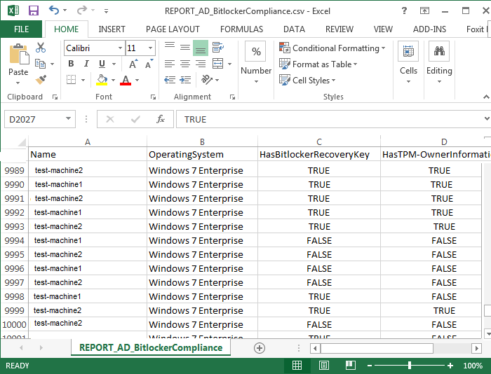
Bitlocker compliance

Slide 13
Bitlocker backup

Slide 14
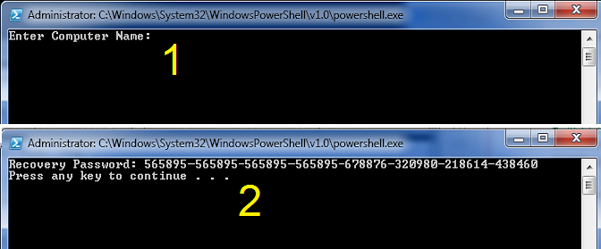
Bitlocker support tool

Slide 15
End goals met
Enabled TPM Chips
Imported the recovery information
Fulfilled the compliance need
Created a disaster recovery backup
Created tool for support staff

Slide 16
Lessons learned
Bitlocker was the right solution
Budgeting - Original assessment was high - Less replacement computers
Other backup solutions - FTP - Email

Slide 17
Questions?

