Slide 1
PS380: Clinical Psychology
Instructor: Sara Barnett, Ed.M., M.S., M.A.
Class 1: Introduction

Slide 2
Agenda
Instructor Introductions
Students Introductions
Course Expectations, Overview, and Assignments
Unit 1 Material: What is clinical psychology?
Questions, Comments, Reflections

Slide 3
Hello and Welcome!

Slide 4
Instructor Contact Information
Email: sbarnett2@kaplan.edu
Phone: 559-246-0620
IM: barnettsara13

Slide 5
Instructor Background
Sara Barnett, Ed.M., M.S., M.A.
- Full-Time Appointment: Brookdale Community College; Lecturer (Lincroft, NJ): Hunter College (NYC)
- Kaplan instructor since March 2009
- Clinical Experience: Mental health counseling in the hospital and school settings
- Research Focus: Multicultural Counseling Competence, Psychosocial Factors that Affect the Education of Students of Color, Race and Racism

Slide 6
Student Introductions
Please share:
1. Where you are from…
2. What you would do on your ideal day off from school/work…
3. Why learning about psychology is interesting to you…

Slide 7
Expectations for Students
1. Respect for classmates is demonstrated during all seminars and throughout the Discussion Boards.
2. Work is completed with care.
3. Work is completed according to assignment guidelines.
4. Work is submitted on time, except in cases of extenuating circumstances (Note: If late work is submitted, please send me an email at the time of its submission).
5. Academic honestly is upheld.

Slide 8
Course Overview
This course encourages students to merge theory and practice, exercising their analytical skills and counseling skills via work on discussion boards, practicums, and projects

Slide 9
Background
What is clinical psychology?

Slide 10
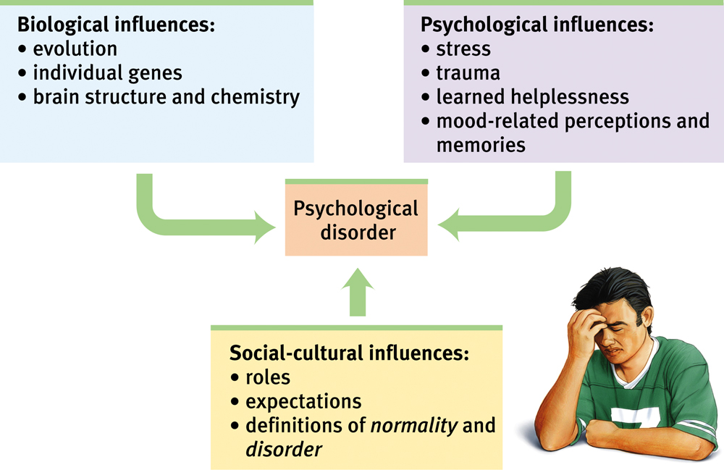
Background
Clinical psychology
Branch of psychology that studies, assesses, and treats people with psychological problems or disorders
Consideration is given to intellectual, emotional, biological, psychological, social, and behavioral aspects of human functioning across the life span, in varying cultures, and at all socioeconomic levels
The term, “clinical psychology,” was coined by Lightner Witmer in 1907 (Note: Witmer opened the first private (counseling) practice in the United States)

Slide 11
Background
What are the credentials needed to become a clinical psychologist?

Slide 12
The Clinician
The Clinical Psychologist (Ph.D.)
Qualified for counseling positions in most all settings
Eligible to open a private practice in all states
Eligible for tenure-track research and teaching positions at all colleges and universities
Note on doctoral programs:
Average Ph.D. program takes 5-7 years to complete
Ph.D. students receive clinical training and participate in intensive research projects
Many Ph.D. students are partially or fully funded
The Psy.D. as an alternative
Licensed Master’s Level Clinicians are sometimes called “psychologists’

Slide 13
The Clinician
The Master’s Level Counselor can work as an…
1. Unlicensed Mental Health Counselors (in hospital, community counseling, college counseling, social agency, residential treatment settings, etc).
2. Licensed Mental Health Counselors (must pass test and accumulate required hours, depending on state requirements) can also work in private practice in some states
3. Specialized Counselor (may require specialized training in addition to Master’s degree +/- licensure):
School Counselor
Certified Substance Abuse Counselor (CASC)
Marriage and Family Therapist

Slide 14
The Clinician
The Bachelor’s Level Counselor can work as a…
Human services associate in state or local government
General case manager
Residential staff person at many inpatient and outpatient mental health, developmental disability, or youth detention facilities

Slide 15
The Clinician
What are the differences between a clinical psychologist, counseling psychologist, psychiatrist and scientist-practitioner?

Slide 16
The Clinician
Clinical Psychologists
Help address mental and emotional issues, with emphasis on psychopathology and treating individual and group ailments
Counseling Psychologists
Help address mental and emotional issues, usually pertaining to common causes for stress, including factors that are work-related, social or familial in nature.

Slide 17
The Clinician
Psychiatrists
Possess a medical degree, which gives them the ability to prescribe medication as well as conduct therapy
Scientist Practitioner
Integrates and stays abreast of findings in the field, uses research to inform practice and/or conducts research while equally engaging in practice

Slide 18
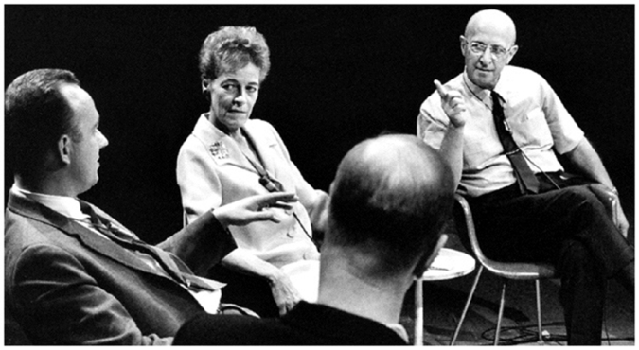
The Therapeutic Approach
What are some basic tenants of providing strong/appropriate care in the clinical setting?

Slide 19
A Therapeutic Approach
1. Check on client’s mood or emotional status and solicit brief updates on recent events.
2. Set and confirm the agenda for the current session.
3. Establish a link to the previous session, often by reviewing previous homework assignment.
4. Progress through the body of the current session, allowing for a great deal of introspection and client sharing, perhaps complemented by skills training, analysis and/or psycho-education
5. Develop and assign new homework assignment (if applicable)
6. Summarize current session; solicit client feedback.

Slide 20
The Career
How does one prepare for a career in clinical psychology and what are some tips?

Slide 21
The Career
Know your professional options.
Take the appropriate undergraduate courses
Get to know your professors
Get research experience
Get clinically relevant experience
Maximize your GRE score
Wisely select graduate programs
Know your long term goals

Slide 22
Questions, Comments, Reflections
???

