Slide 2
Exam Prep | Exam AZ-103: Microsoft Azure Administrator
Josue Vidal
Senior Cloud Solution Architect
GFT Group
Carlos Mattos
Director of Technology and Innovation
GFT Group
BRK3201

Slide 3

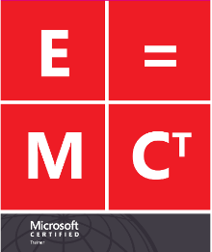





Hello ME!
Josue Vidal
Senior Cloud Solution Architect and Co-founder IgniçãoTI
Vidal has +16 years of professional expertise in the Microsoft Infrastructure segment, with a main focus on Microsoft Azure nowadays, relying on a background in Active Directory and System Center.
..help leverage and accelerate the career of IT professionals to achieve their goals, being recognized and having an excellent career.
Based out of Sao Paulo, he is known as a subject matter expert, always able to provide training in a fun and enthusiastic way.
Vidal is a MCT for +12 years, and an MVP for 10 years.
Senior Cloud Solution Architect at GFT Brazil.
Vidal is a technical writer for IgniçãoTI, courseware author for Microsoft and several training partners.
josue.vidal@ignicaoti.com.br
https://josuevidal.com.br/
/josuevidal
@josuevidall
/josuevidal
@josuevidall

Slide 4


Hello ME!
Carlos Mattos
Director of Technology and Innovation
Team leader with a track record of success and over 18 years of experience in global enterprise software development, strategy, sales, business development and operations for the software market.
Director of Technology and Innovation at GFT Brazil.
Recognized by Microsoft as Most Valuable Professional for 12 years (2003-2016) for its contributions to the technical and academic communities.
Received the Microsoft ACE Award in 2005 for contributions to Visual Studio.
He was named Microsoft Regional Director in 2017-2019.
Professor, writer, speaker, and technology evangelist, and loves talking about career and workplace behavior.
/carlosmattos
@cmattos

Slide 5
Tips and Tricks
What is your methodology of study?
Mind Map
Study Plan
Videos
Pratice
Simulate
Clarify
Path
Content
Concept
Knowledge

Slide 6


Key takeaways
Key takeaway 1
Session objective(s): help you prepare for exam AZ-103
Key takeaway 2
Exam topics and breakdown of questions
Key takeaway 3
Exam study material, links, resources

Slide 7
Certification overview

Slide 8
Azure Applications and Infrastructure certifications
Fundamentals
Role-based
Specialty
Associate
Expert
Microsoft Certified:
Azure Administrator Associate
Microsoft Certified:
Azure for SAP Workloads Specialty*
OR
Microsoft Certified:
Azure DevOps Engineer Expert
Microsoft Certified:
Azure Fundamentals
(Optional)
Microsoft Certified:
Azure Developer Associate
Microsoft Certified:
Azure Security Engineer Associate
Key
Optional Path
Microsoft Certified:
Azure Solutions Architect Expert
Required Path
*
Exam in beta

Slide 9

Azure Administrator audience profile
Azure Administrator
Audience profile:
Azure Administrators manage cloud services that span storage, security, networking, and compute cloud capabilities. They have a deep understanding of each service across the full IT lifecycle, and take requests for infrastructure services, applications, and environments. They make recommendations on services to use for optimal performance and scale, as well as provision, size, monitor, and adjust resources as appropriate.
In addition, Azure Administrators should have proficiency in using PowerShell, the Command Line Interface, Azure Portal, ARM templates, operating systems, virtualization, cloud infrastructure, storage structures, and networking.

Slide 10
Learning path for Azure Administrator Associate
Skills required for certification
Exams
Certification
Azure subscriptions
& resources
Storage solutions
AZ-103: Microsoft Azure Administrator
Online courses and instructor-led training available to support learning
Microsoft Certified:
Azure Administrator Associate
Start here
Virtual machines
Virtual networks
Identity management

Slide 11
Exam basics
40-60 questions
  Some questions worth
  more than 1 point
  Answer all the questions
    No penalty for guessing
    Some questions cannot
    be skipped!
  Mark items for review
  if you’re not sure of
  your answer
Plan for 180 minutes
150 minutes to
answer questions
30 minutes for
instructions, comments, score reporting, etc.
More than just multiple-choice questions!
Build list, hot area, active screen, drag and drop, etc.
Performance based
coming soon!
Case Studies
Detailed information on business and technical requirements; existing environment and other background you need to
solve problems
Requires you to understand
and integrate information across multiple sources, determine what’s important, and make the best decision

Slide 12

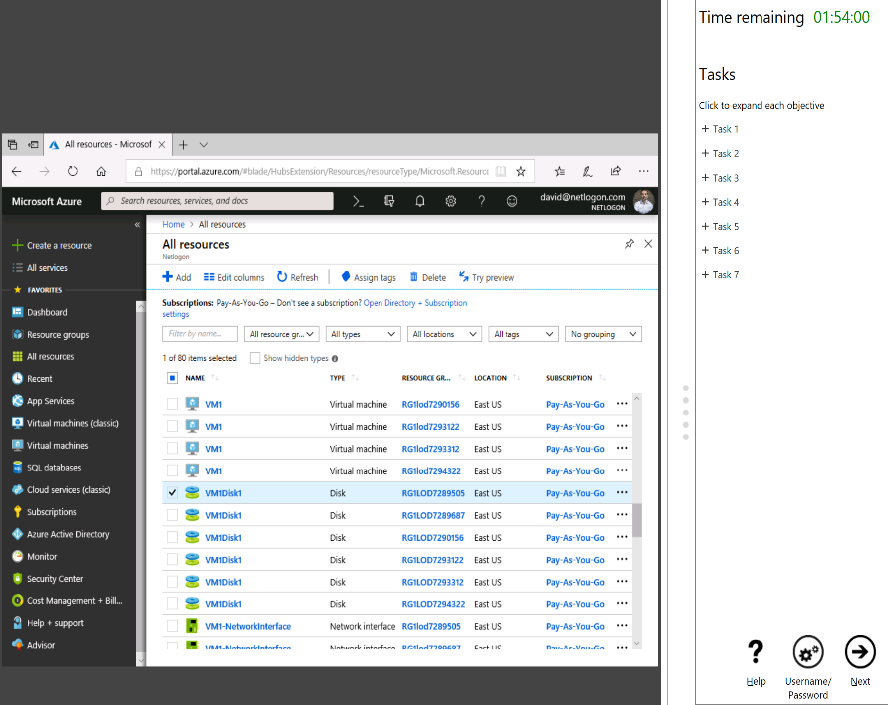


Performance-based testing - prove your skills with hands-on labs
Applies to role-based certifications with at least one exam per certification
Real-world scenarios where you configure, manage resources and services
Demonstrate your hands-on skills
1 or 2 labs with up to 15 tasks that you need to complete

Slide 13
Exam overview and objective domain

Slide 14
Tips and Tricks
What is your methodology of study?
Mind Map
Study Plan
Videos
Pratice
Simulate
Clarify
Path
Content
Concept
Knowledge

Slide 15

Exam AZ-103 - Objective Domain
Manage Azure subscriptions and resources (15-20%)
Implement and manage storage (15-20%)
Deploy and manage virtual machines (VMs) (15-20%)
Configure and manage virtual networks (30%-35%)
Manage identities (15-20%)

Slide 16
Manage Azure subscriptions and resources (15–20%)
Manage Azure subscriptions
  May include but not limited to: Assign administrator permissions; configure cost center quotas and tagging; configure subscription policies
Analyze resource utilization and consumption
  May include but not limited to: Configure diagnostic settings on resources; create baseline for resources; create and test alerts; analyze alerts across subscription; analyze metrics across subscription; create action groups; monitor for unused resources; monitor spend; report on spend; utilize Log Search query functions; view alerts in Log Analytics
Manage resource groups
  May include but not limited to: Allocate resource policies; configure resource locks; configure resource policies; implement and set tagging on resource groups; move resources across resource groups; remove resource groups
RBAC & Policies
Tagging & Cost Management
Monitor & Diagnostics
Log Analytics
Move Resources

Slide 17



Manage Azure Subscriptions: Understand the Scaffold
Azure Resource policy
& audit
Naming standards
Resource tags
Resource locks
Resource groups
Azure automation
Role-based access controls
Azure Security Center
Subscriptions
Account/enterprise agreement
aka.ms/Azure/Scaffold

Slide 18
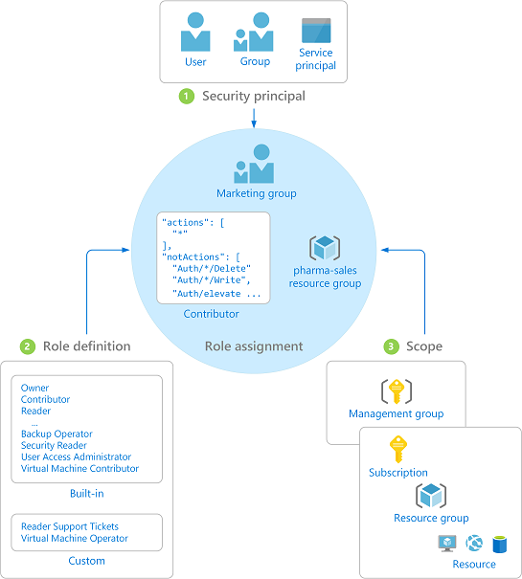
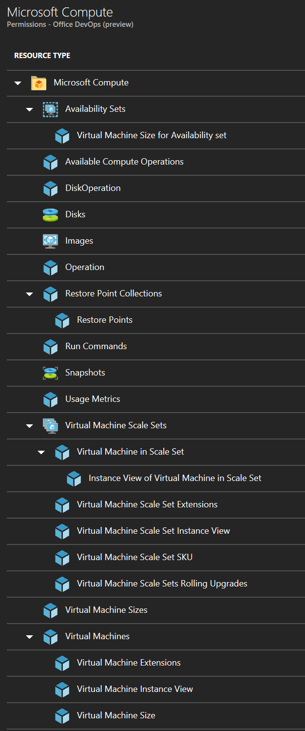
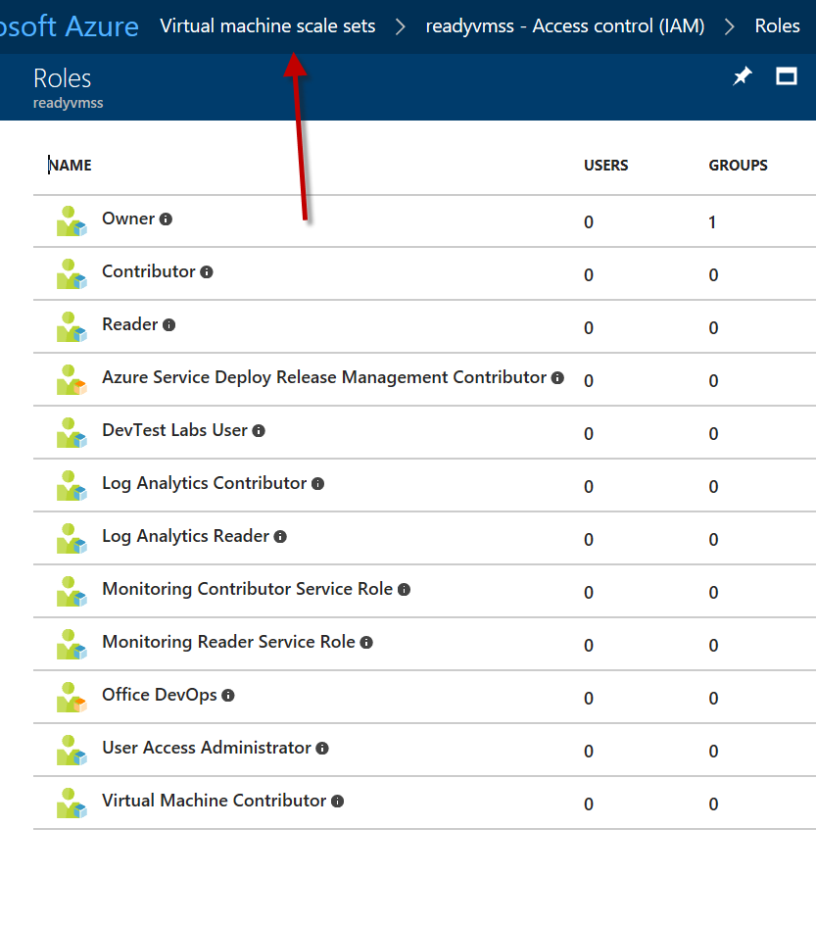
Manage Azure Subscriptions
RBAC Administrator Permissions
aka.ms/Azure/Subscriptions aka.ms/Azure/RBAC

Slide 19
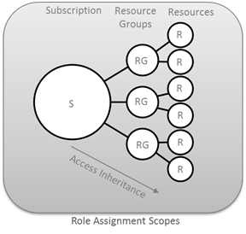
Role-Based Access Control
ROLE NAME | DESCRIPTION
Contributor | Contributors can manage everything except access.
Owner | Owner can manage everything, including access.
Reader | Readers can view everything, but can't make changes.
User Access Administrator | Lets you manage user access to Azure resources.
Virtual Machine Contributor | Lets you manage virtual machines, but not access to them, and not the virtual network or storage account they're connected to.

Slide 20
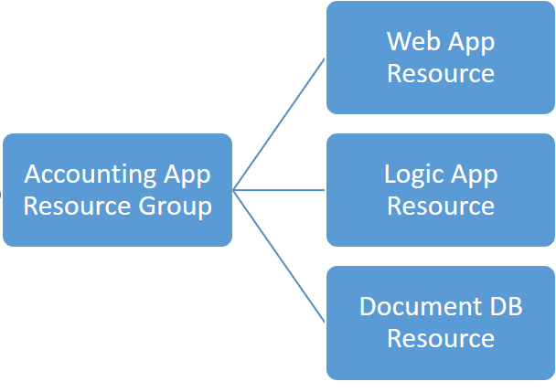
Role-Based Access Control
Subscription
Resource Group
Resource
Resource Group
Resource
Resource
Resource Group
Resource
Resource
Subscription
Resource Groups
Resources

Slide 21
Analyze Resource Utilization and Consumption
Configure diagnostic settings on resources;
create baseline for resources;
create and rest alerts;
analyze alerts across subscription;
analyze metrics across subscription;
create action groups;
monitor for unused resources; monitor spend; report on spend;
utilize Log Search query functions;
view alerts in Log Analytics
https://docs.microsoft.com/en-us/azure/monitoring-and-diagnostics/monitoring-overview

Slide 22
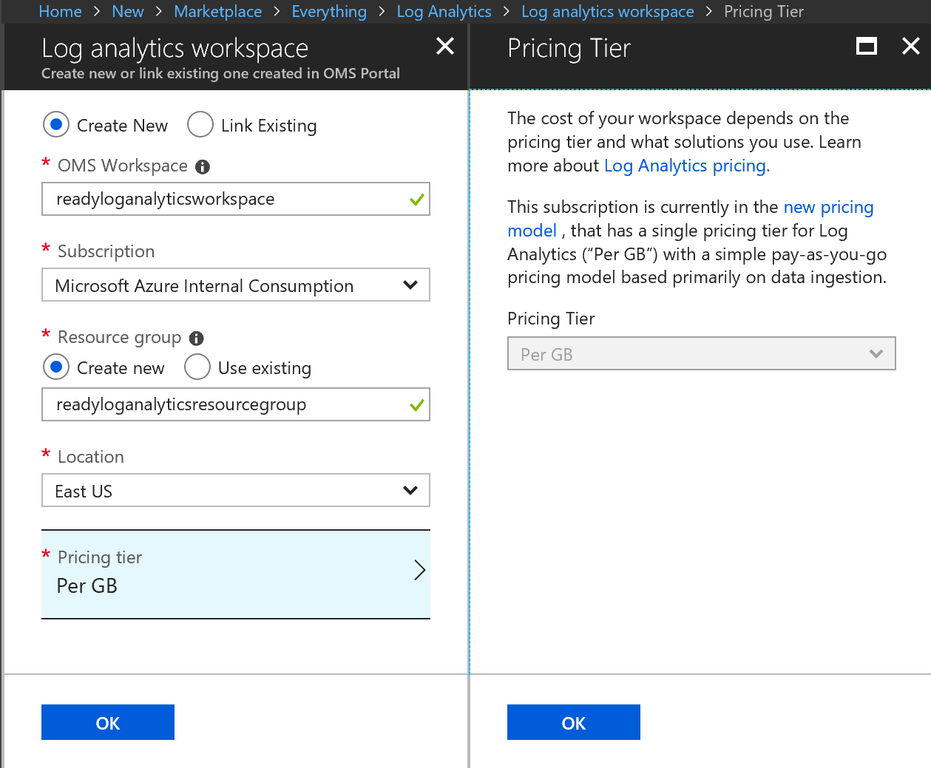
Analyze Resource Utilization and Consumption
Log Analytics
Configure diagnostics on resources
Custom visualizations
Analyze alerts
  Across subscriptions
Analyze metrics
  Across subscriptions
https://portal.loganalytics.io/

Slide 23

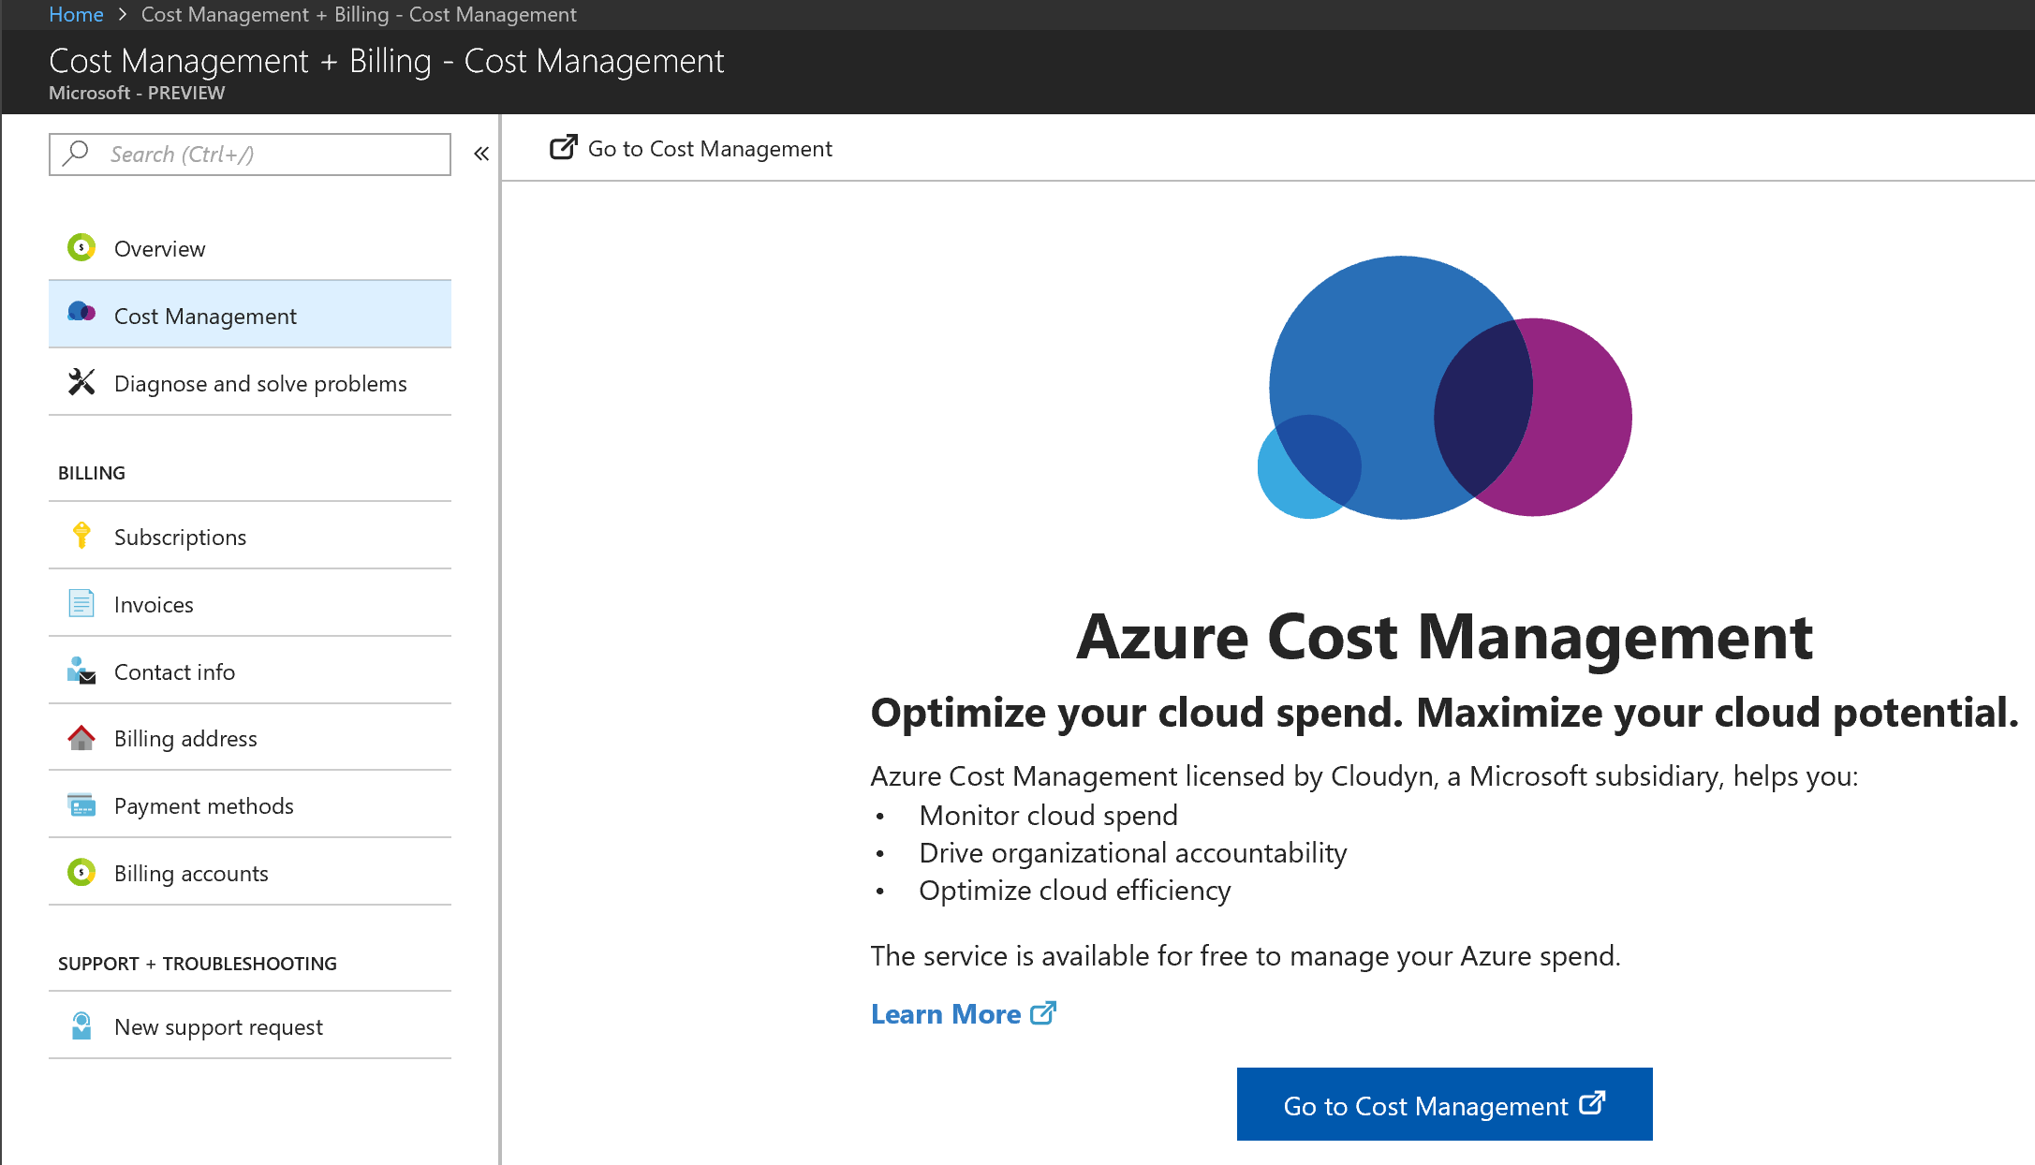
Analyze Resource Utilization and Consumption
Cost Management
https://docs.microsoft.com/en-us/azure/cost-management/overview
Analyze usage
Monitor spend
Report on spend
Optimize
  Reserved Instances
  Sizing Recommendations

Slide 24

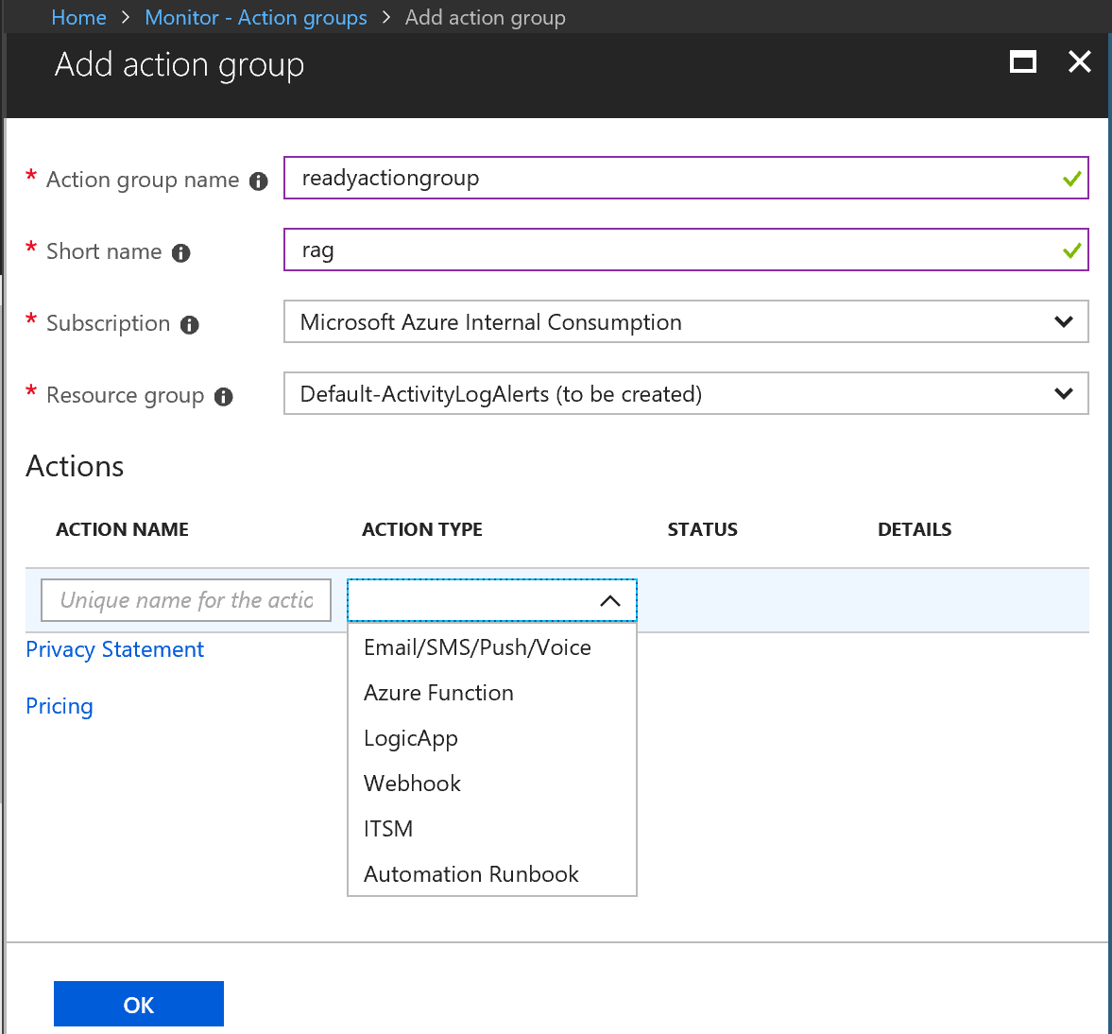
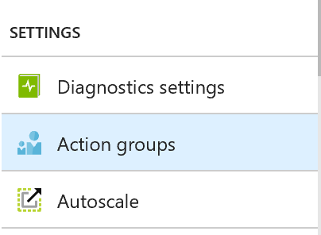
Analyze Resource Utilization and Consumption
Create Action Groups
Define an Action Type
  Email / SMS / Push / Voice
  Function or LogicApps
  Webhook / Azure Automation
  ITSM integration

Slide 25
Manage Resource Groups | Move Resources
Checklist:
Common Azure AD Tenant
  If not the same
    Transfer Ownership
    Associate or add an Azure Subscription
Common Resource Providers
Quotas Exceeded?
Minimum Permissions
  Microsoft.Resources/subscriptions/resourceGroups/moveResources/action on the source resource group.
  Microsoft.Resources/subscriptions/resourceGroups/write on the destination resource group.
Limit of 800 moves, possible timeouts

Slide 26
Manage Resource Groups | Not supporting move:
Express Route
Kubernetes Service
Lab Services – not across subscriptions
Load Balancers
Managed Applications
Managed Disks
Microsoft Genomics
NetApp
Public IP
Recovery Services vault
SAP HANA on Azure
Security
Site Recovery
StorSimple Device Manager
Virtual Networks (classic)
AD Domain Services
AD Hybrid Health Service
Application Gateway
Azure Database for MySQL
Azure Database for PostgreSQL
Azure Database Migration
Azure Databricks
Azure Migrate
Batch AI
Certificates - App Service Certificates can be moved,
but uploaded certificates have limitations.
Container Instances
Container Service
Data Box
Dev Spaces
Dynamics LCS

Slide 27
Demo
Manage Resource Groups | Move Resources

Slide 28
Implement and Manage Storage (15-20%)
Create and configure storage accounts
  May include but not limited to: Configure network access to the storage account; create and configure storage account; generate shared access signature; install and use Azure Storage Explorer; manage access keys; monitor activity log by using Log Analytics; implement Azure storage replication
Import and export data to Azure
  May include but not limited to: Create export from Azure job; create import into Azure job; configure and use Azure blob storage; configure Azure content delivery network (CDN) endpoints
Configure Azure files
  May include but not limited to: Create Azure file share; create Azure File Sync service; create Azure sync group; troubleshoot Azure File Sync
Implement Azure backup
  May include but not limited to: Configure and review backup reports; perform backup operation; create Recovery Services Vault; create and configure backup policy; perform a restore operation
Storage Accounts
SA security
Blob Storage & CDN
Azure File Sync & File Share
Azure Backup (Hybrid !!)

Slide 29
Create and Configure Storage Accounts
Key topics to understand:
Services:
  Blobs, Files, Tables, Queues
Security:
  Storage Access Keys
  Shared Access Signatures
  Replication
    LRS, ZRS, GRS, GRS-RA
3 different scenarios:
General-Purpose:
  Blobs, Files, Tables, Queues
General-Purpose v2:
  Blobs, Files, Tables, Queues
  Blob Storage Account:
    Block & Append blob
    No Page blob
aka.ms/Azure/Storage
MUST Read How To

Slide 30
Import and Export Data to Azure
Azure Storage integration
Azure Storage Accounts and Managed Disks
  Regular data types go to Azure Storage Accounts (blobs)
  VHD disk upload to Azure Marketplace custom deployments
Storage Account Explorer
  GUI or Rest API
Portal, PowerShell, Azure CLI
Data is more than Azure Storage
  Databases (SQL, MySQL, CosmosDB,…)

Slide 31
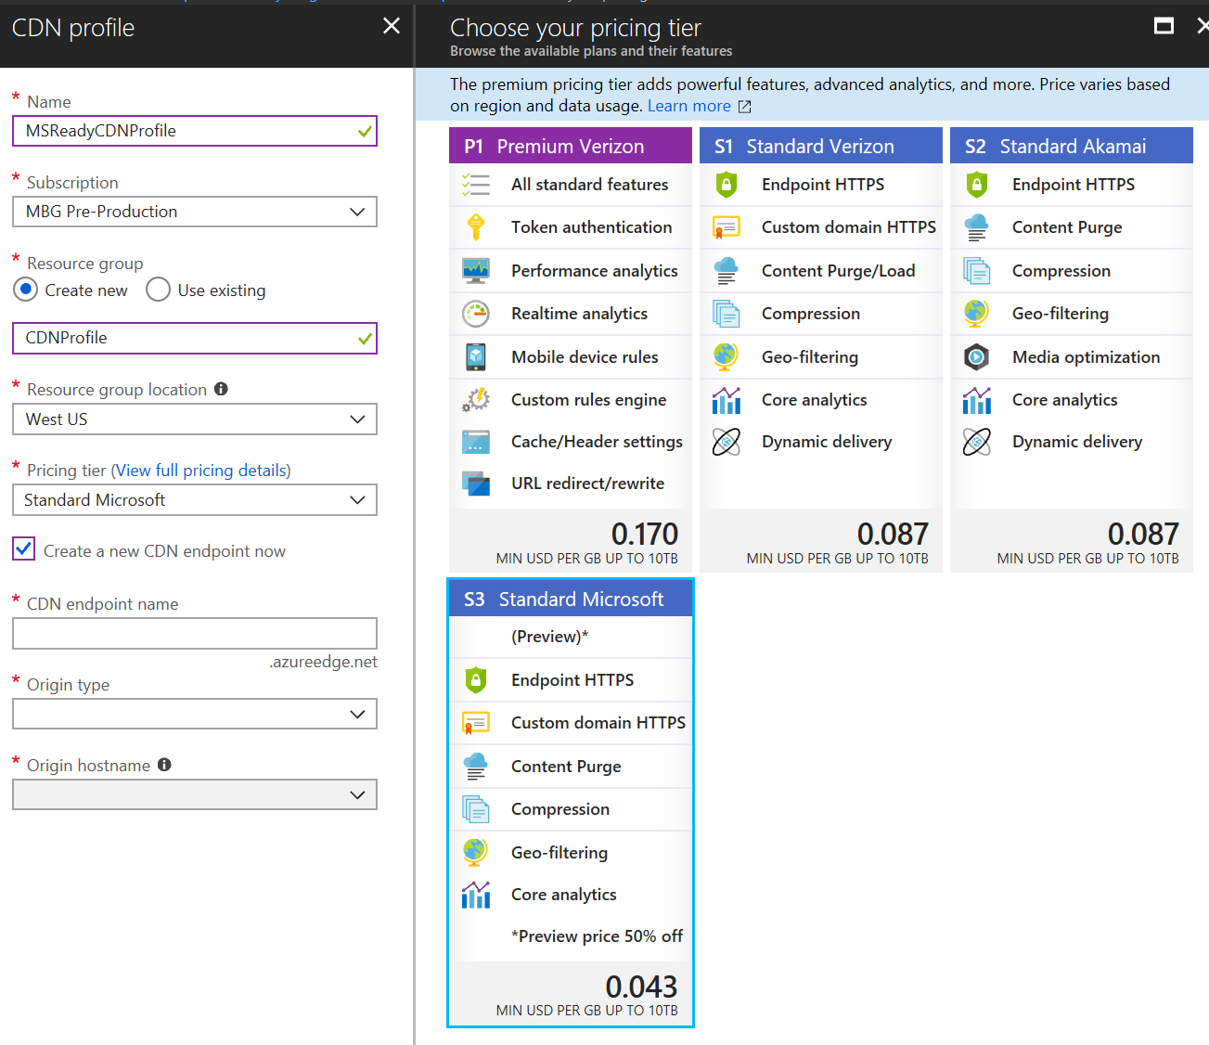
Import and Export Data to Azure
Configure Azure content delivery network (CDN) endpoints
Create a CDN Profile
Create a New CDN Endpoint
Wait
  Microsoft CDN profiles: 10 minutes.
  Akamai CDN profiles: 1 minute.
  Verizon profiles: 90 minutes.
Know the difference between Standard and Premium Pricing Tiers
aka.ms/Azure/CDN

Slide 32
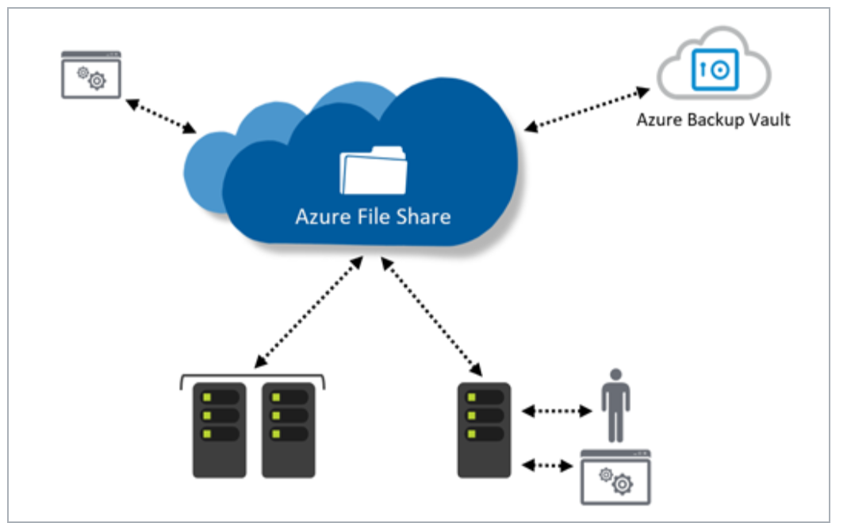
Configure Azure Files | Azure File Sync
Azure File Sync Service
Supported on
  Windows Server 2012R2/16
  NTFS Volumes/Compression
  DFS with 1.2 Agent
  BitLocker, AIP, AAD RMS,
NOT supported
  Other file systems period
  Sysprep
  NTFS EFS
  No Other HSM
Azure Sync Group
Defines Sync Topology for set of files
aka.ms/azure/files Deploy Azure File Sync

Slide 33
Implement Azure Backup
Azure Backup Scenarios:
Files & Folders
  Azure Backup Agent
Full Systems
  Azure Backup Server (or DPM)
Azure Virtual Machines
  Azure VM Backup
What to know:
How to deploy
Policies
Dependencies
Monitoring & Reporting
Limitations
aka.ms/Azure/Backup

Slide 34
Demo
Azure File Sync

Slide 35
Deploy and Manage Azure Virtual Machines (15-20%)
Create and configure a VM for Windows and Linux
  May include but not limited to: Configure high availability; configure monitoring, networking, storage, and virtual machine size; deploy and configure scale sets
Automate deployment of VMs
  May include but not limited to: Modify Azure Resource Manager (ARM) template; configure location of new VMs; configure VHD template; deploy from template; save a deployment as an ARM template; deploy Windows and Linux VMs
Manage Azure VM
  May include but not limited to: Add data disks; add network interfaces; automate configuration management by using PowerShell Desired State Configuration (DSC) and VM Agent by using custom script extensions; manage VM sizes; move VMs from one resource group to another; redeploy VMs
Manage VM backups
  May include but not limited to: Configure VM backup; define backup policies; implement backup policies; perform VM restore
VM end-to-end
ARM-template
Deployment
PowerShell DSC, VM extensions
Azure VM Backups
Windows & Linux

Slide 36
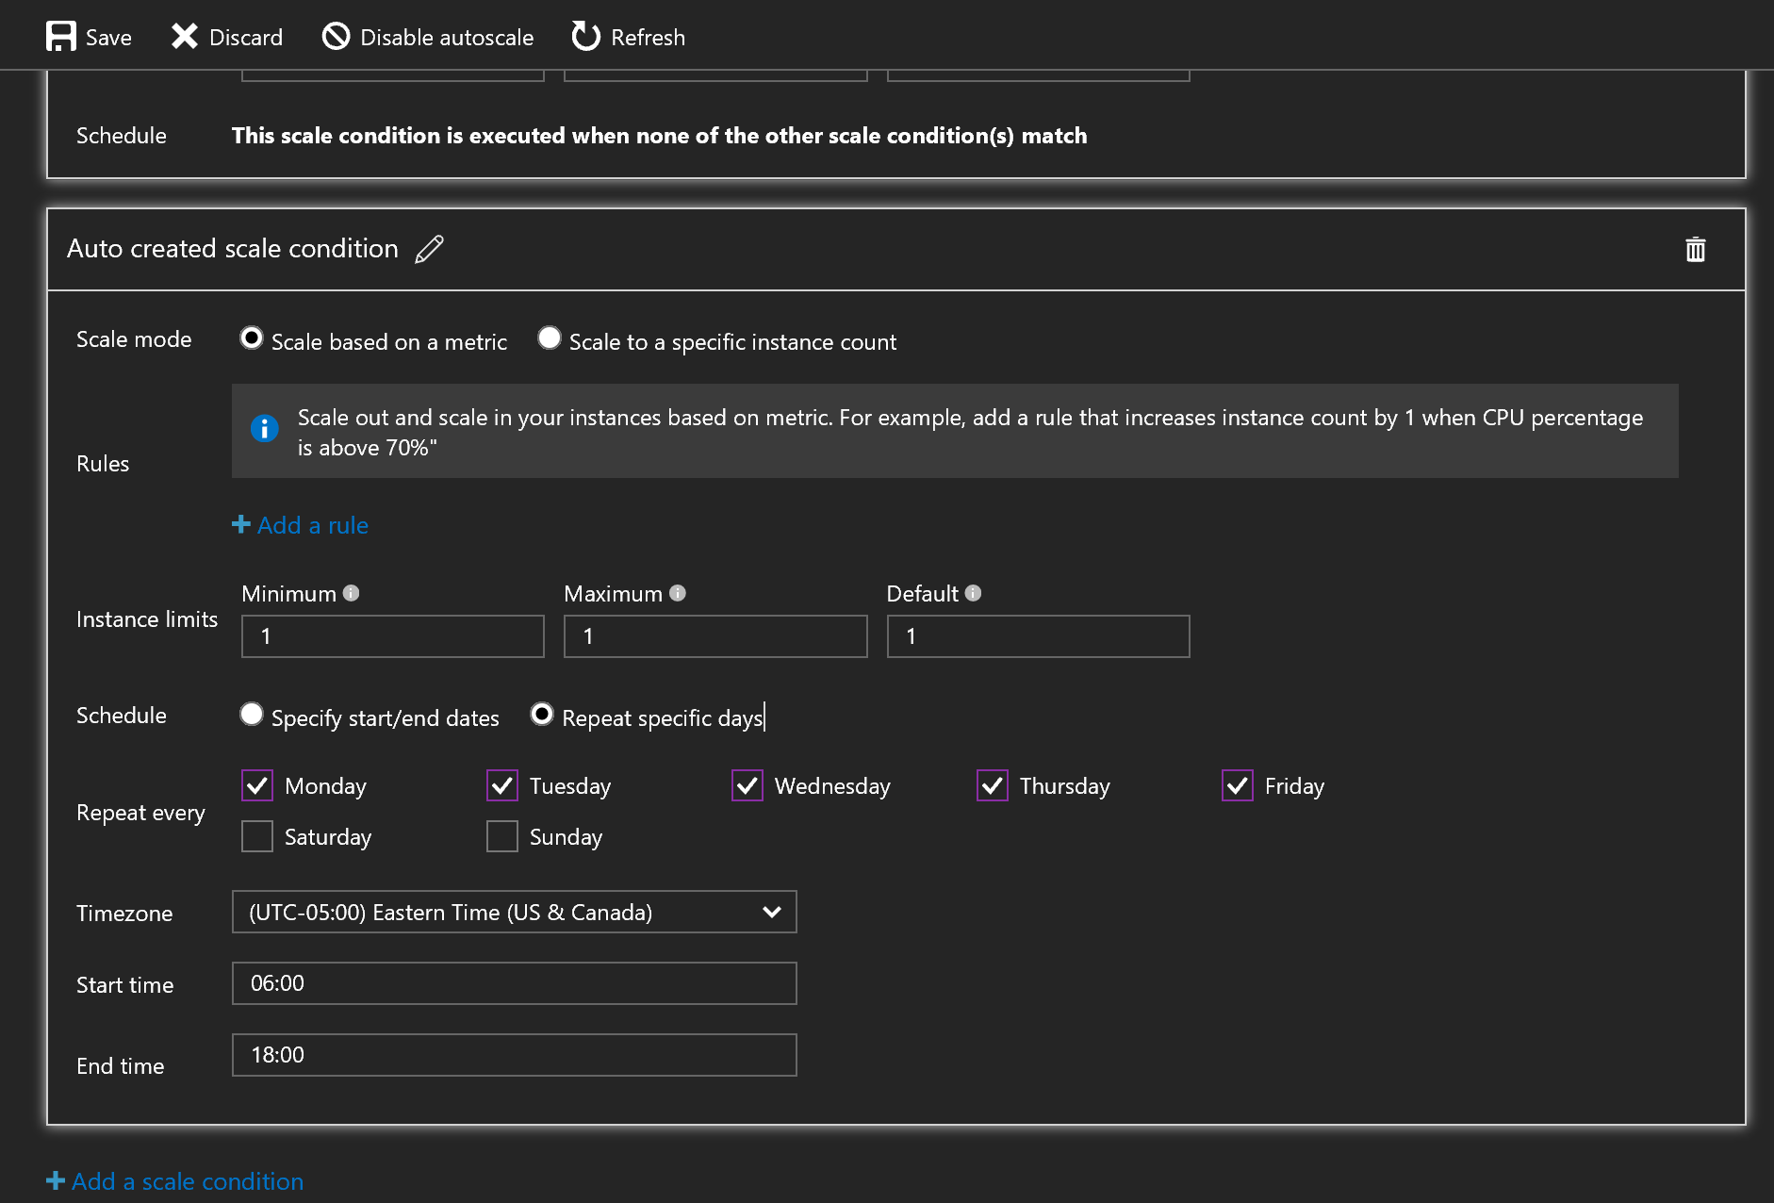
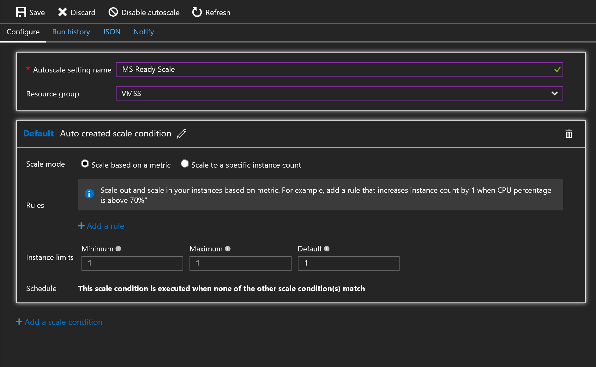
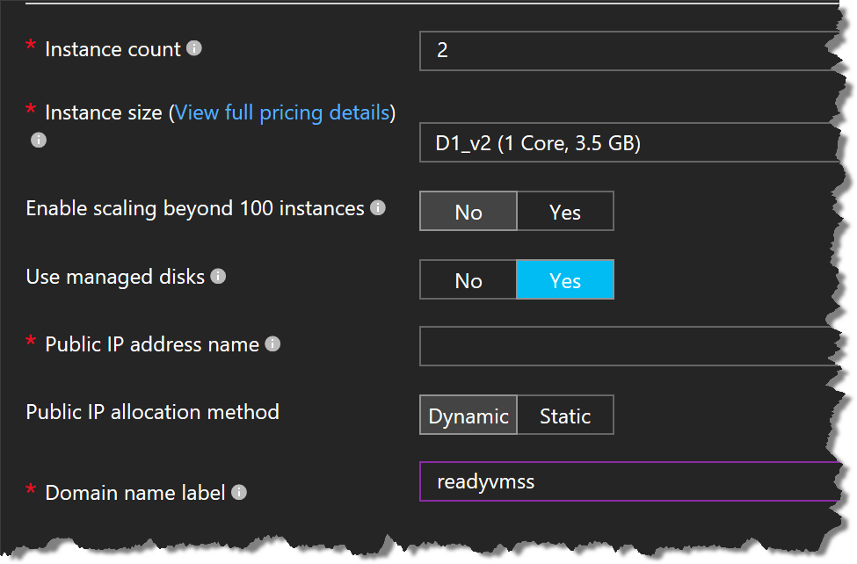
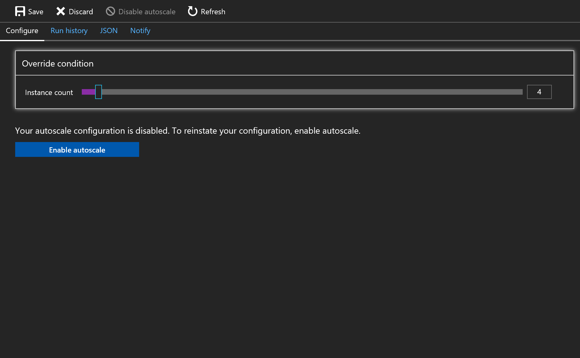
Create and Configure a VM for Windows and Linux
aka.ms/Azure/VMSS

Slide 37
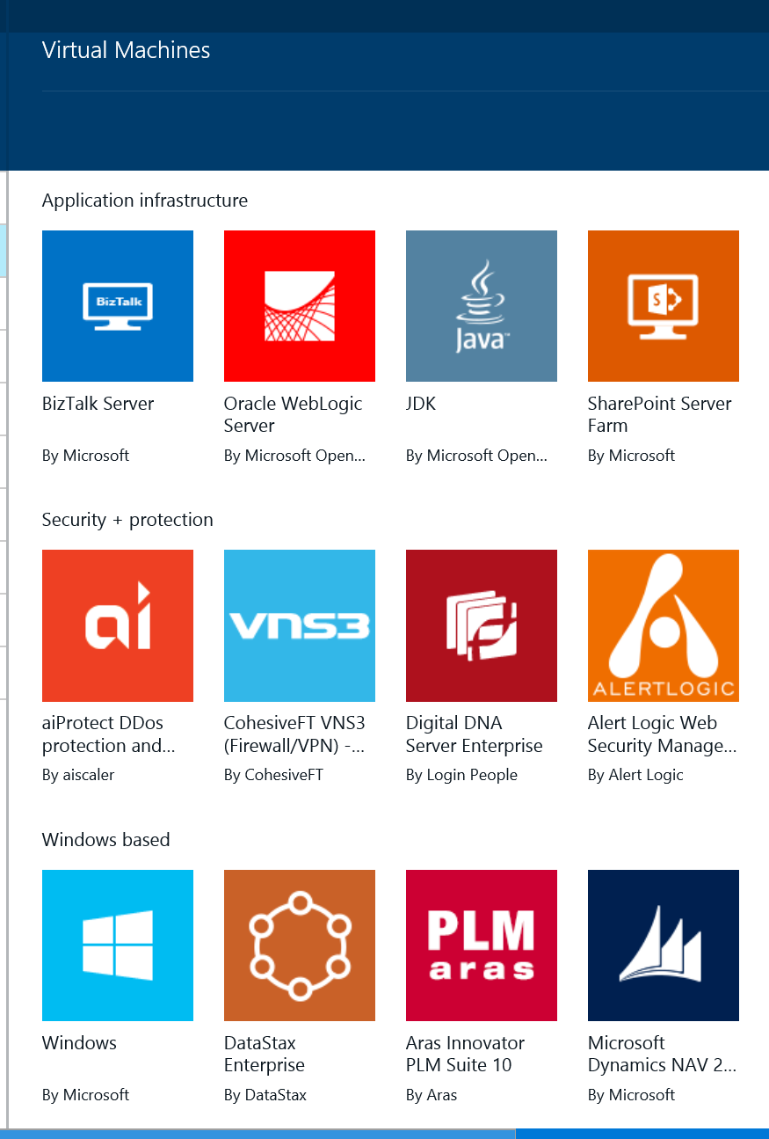
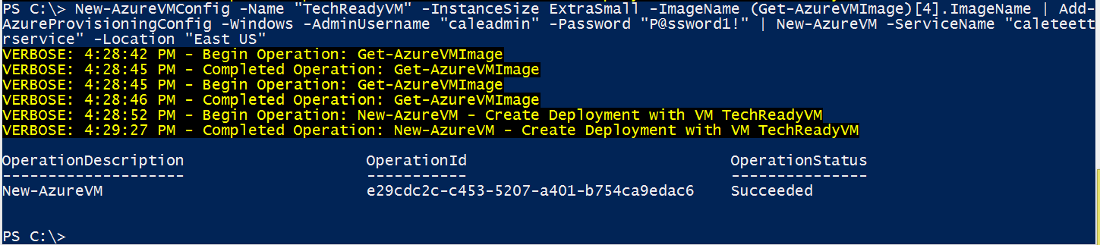
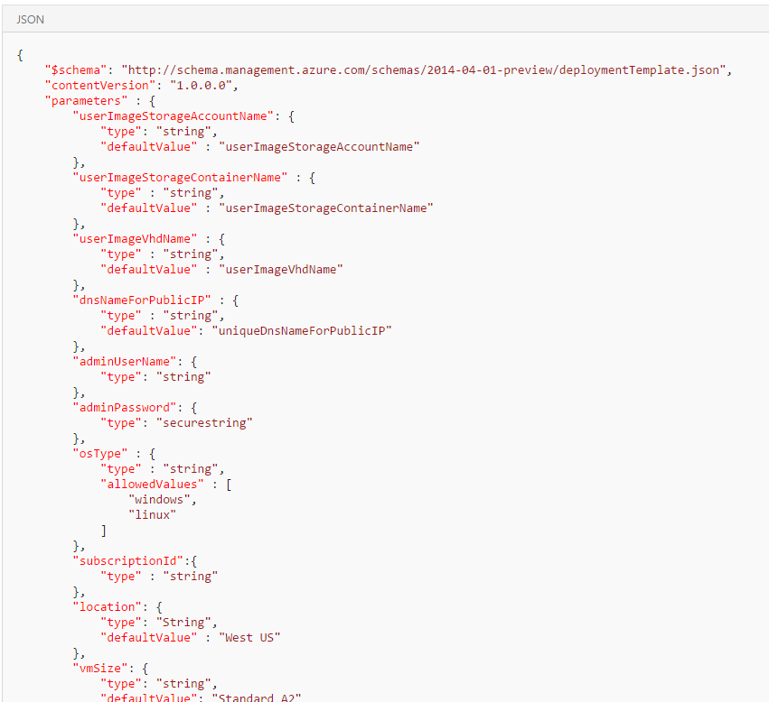
Automate Deployment of VMs
Deployment options
Marketplace
PowerShell
Azure CLI
ARM Template
Portal
Code (C#/Java/Python)
Different ways to create a VM

Slide 38
Automate Deployment of VMs
ARM Templates
JSON files with a predefined syntax and schema
Azure and Azure Stack compatible
Deployment from:
  Azure Portal / Add Resource / Template Deployment
  PowerShell
  Azure CLI
GitHub -> Azure QuickStart Templates
Visual Studio Code
Visual Studio 2015 and up (all editions)
ARM Template Walkthrough

Slide 39
Manage Azure VM
Desired State Configuration (DSC)
Configuration Contosoweb app
{
param ($MachineName)
Node $MachineName
{
#Install the WebServer
WindowsFeature IIS
{
Ensure = "Present"
Name = "Web-Server"
}
#Install ASP.NET 4.5
WindowsFeature ASP
{
Ensure = "Present"
Name = "Web-Asp-Net45"
}
}
}
DSC configurations separate intent, or "what I want to do", from execution, or "how I want to do it.“
DSC is also repeatedly checking if the VM is still according the desired state, where script extension only runs once.
DSC Template Overview

Slide 40
Demo
Desired State Configuration (DSC)

Slide 41
Configure and Manage Virtual Networks (30-35%) – part 1
Create connectivity between virtual networks
  May include but not limited to: Create and configure VNET peering; create and configure VNET to VNET; verify virtual network connectivity; create virtual network gateway
Implement and manage virtual networking
  May include but not limited to: Configure private and public IP addresses, network routes, network interface, subnets, and virtual network
Configure name resolution
  May include but not limited to: Configure Azure DNS; configure custom DNS settings; configure DNS zones
Create and configure a Network Security Group (NSG)
  May include but not limited to: Create security rules; associate NSG to a subnet or network interface; identify required ports; evaluate effective security rules
VNET Peering
VNET end-to-end
Azure DNS
(Hybrid!!)
Network Security Groups (NSGs)
VPN and ER
(Basics)

Slide 42
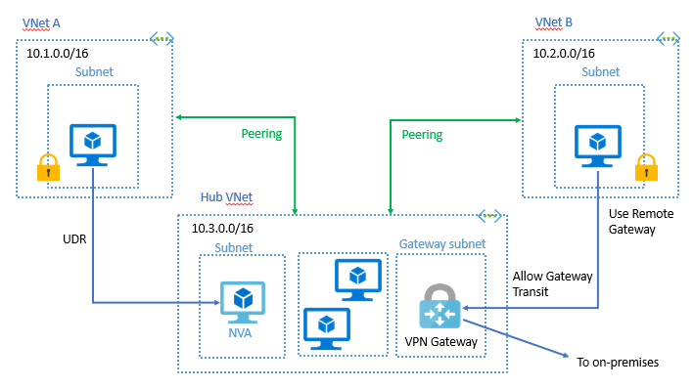
Create Connectivity Between Virtual Networks
Create and configure VNET peering
Benefits
    Connect 2 VNets in same region
    Routed through Azure Backbone
    (= no custom encryption like S2S VPN)
Requirements
    Same Region & Across Regions
    Non-overlapping IP Addresses
    No Transitivity
  Capabilities
    Open or Close NSGs
    Internal DNS only within VNet, no Azure DNS across
Peering uses the MS Backbone; if you want
(custom) additional encryption, use S2S VPN
aka.ms/Azure/Peering

Slide 43
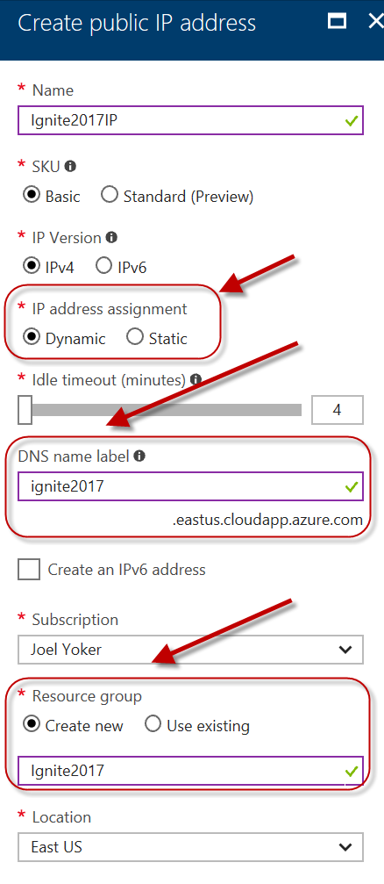
Implement and Manage Virtual Networking
Public IP
    Separate Azure Object
    Public Azure Service
    VMs, ILBs, VPN, App GWs
    Dynamic (default) or Static
    DNS hostname resolution
Private IP
    Allocated from subnet range
    Internal resolution by Azure DNS
    Subnet, part of VNet range
    VM, ILBs, App GWs
    Dynamic (default) or Static
aka.ms/Azure/Addresses

Slide 44
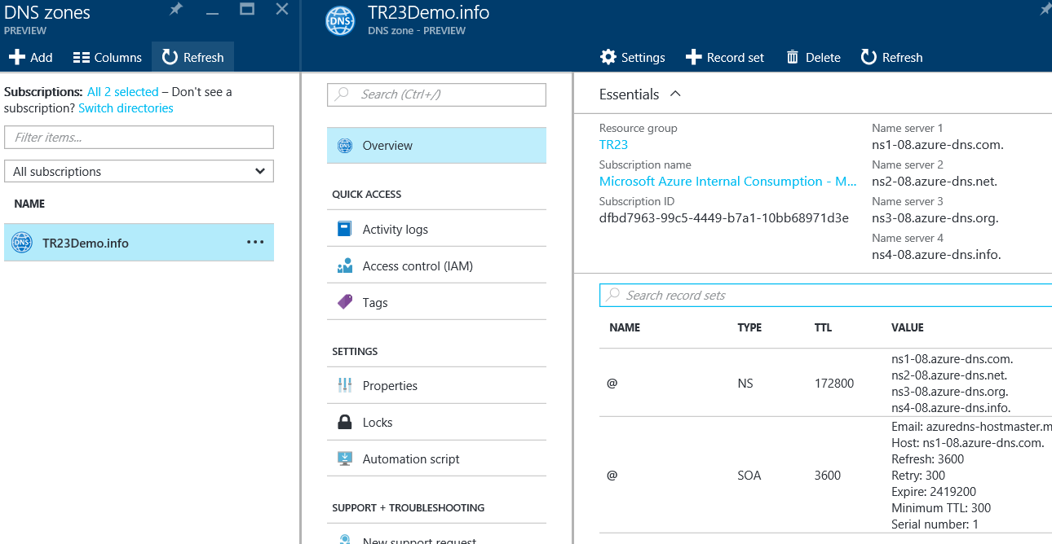
Configure Name Resolution
Create DNS Zone
  Zone name must be unique within Resource Group
  Can add Azure Tags for Billing or Grouping
  Creating the zone makes SOA and NS records in Azure
Create DNS Record
  Azure DNS supports all common records
  Use Record Sets for more than one record of same name and type + wildcard!
  SOA and CNAME are exceptions to Rule above
Delegate Domain to Azure DNS
  Must know zone server names
  Get-AzureRmDnsZone –Name contoso.net –ResourceGroupName MyResourceGroup
aka.ms/Azure/DNS

Slide 45
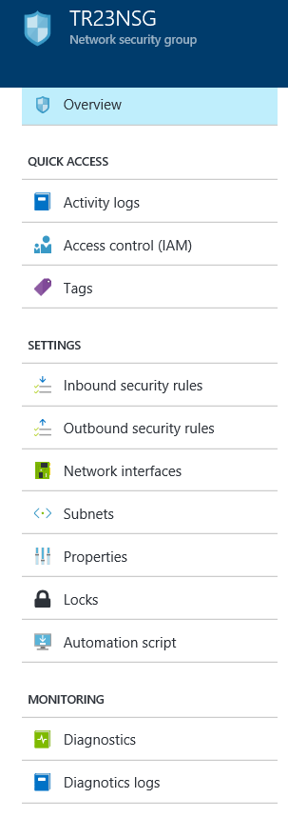
Create and Configure a Network Security Group (NSG)
  Apply at Subnet or NIC
  Only 1 NSG per Azure Resource
  Only TCP or UDP
Special Rules
  Microsoft Owned IP Address of 168.63.129.16
  Outbound Port 1688 reserved for KMS
  aka.ms/Azure/NSG

Slide 46
Demo
Configure Name Resolution

Slide 47
Implement Advanced Virtual Networking (30-35%) – part 2
Implement Azure load balancer
  May include but not limited to: Configure internal load balancer, load balancing rules, and public load balancer; manage Azure load balancing
Monitor and manage networking
  May include but not limited to: Monitor on-premises connectivity; use network resource monitoring and Network Watcher; manage external networking and virtual network connectivity
Integrate on premises network with Azure virtual network
  May include but not limited to: Create and configure Azure VPN Gateway; create and configure site to site VPN; configure Express Route; verify on premises connectivity; manage on-premise connectivity with Azure
Azure Load Balancers
VPN
Network Watcher
ExpressRoute

Slide 48
Azure Load Balancer Characteristics
Basic
Up to 100 backend instances
Non-zonal frontend
Availability Set (single)
Basic NAT and Probe health status
no HA Ports
NSG optional
Free
Standard
Up to 1000 backend instances
Zone-redundant frontend Zonal frontend
Availability Sets not required and Availability Zones
Integrated Frontend and Backend health metrics
Supports HA Ports
NSG required
Charged based on number of rules, data processed inbound and outbound associated with resource.
Notes:
This slide, like mentioned above is for multiple pointers. The information above covers the types of information that can be used in this slide

Slide 49



Azure External Load Balancer
    Internet-facing IP-address
    Load Balances ALL traffic
    (TCP, UDP – all ports)
    Required when deploying Virtual Machine
    Availability Sets
    Can communicate with Azure Internal
    Load Balancer and/or Application Gateway
AzLB
194.2.5.78
Availability Set
WebVM2
10.1.0.5
WebVM1
10.1.0.6
WebVM3
10.1.0.7
Notes:
This slide, like mentioned above is for multiple pointers. The information above covers the types of information that can be used in this slide

Slide 50

Azure Internal Load Balancer
    Private-facing IP-address
    Load Balances ALL traffic
    (TCP, UDP – all ports)
    Sits behind an External Load Balancer
    Keep in mind:
    An Azure Load Balancer cannot combine
    external and internal traffic at the same
    time
AzextLB
194.2.5.78
Availability Set
WebVM2
10.1.0.5
WebVM1
10.1.0.6
WebVM3
10.1.0.7
AzintLB
10.4.0.25
Availability Set
SQLVM2
10.4.0.5
SQLVM1
10.4.0.6
SQLVM3
10.4.0.7
Notes:
This slide, like mentioned above is for multiple pointers. The information above covers the types of information that can be used in this slide

Slide 51
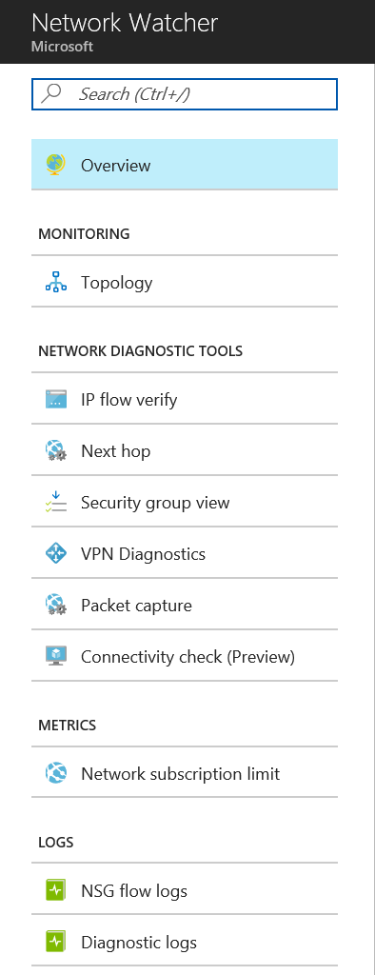
Azure Network Watcher
Recently added Networking feature, providing
  Topology
  Variable Packet Capture
  IP Flow Verify
  Next Hop
  Diagnostics Logging
  Security Group View
  NSG Flow Logging
  VPN Gateway Troubleshooting
  Network Subscription Limits
  Role Based Access Control
  Connectivity

Slide 52
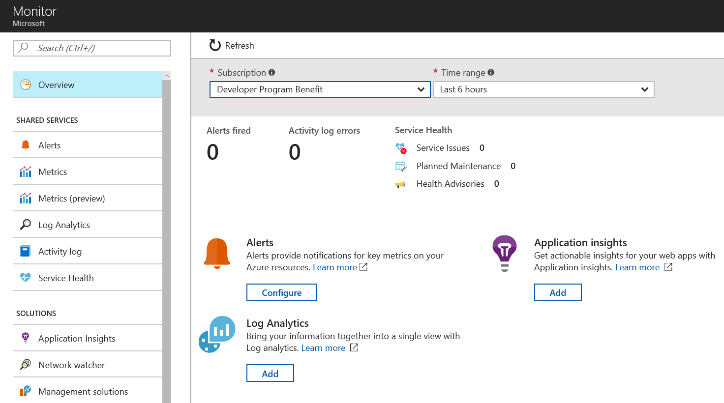
Azure Network Monitor
Centralized hub for different Azure Resources Monitoring aspects:
  Alerts
  Metrics
  Log Analytics
  Service Health
  Application Insights
  Network Watcher

Slide 53
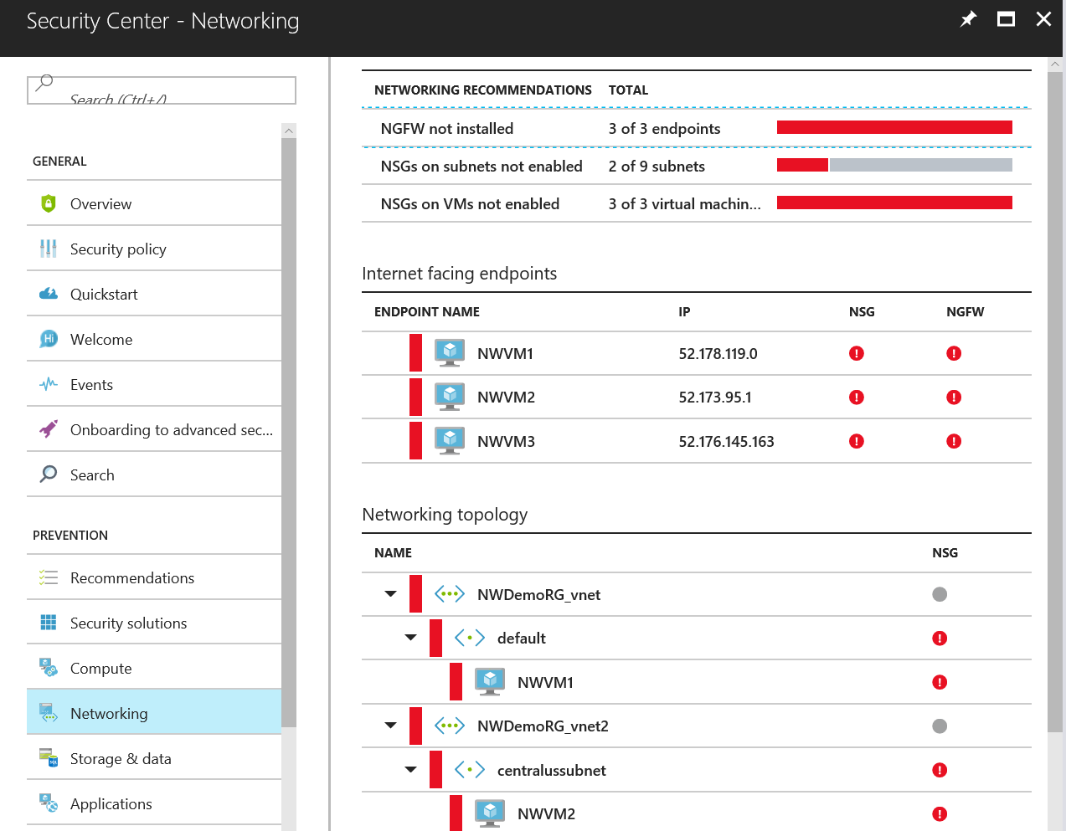
Azure Security Center - Networking
Centralized Dashboard, focusing on Security posture of Azure and hybrid systems and applications
Active in 3 different areas:
  General Security View
  Prevention
  Detection
Networking Features:
  Networking Recommendations
  Internet Facing Endpoints security view
  Networking Topology security view

Slide 54
Manage Identities (15-20%)
Manage Azure Active Directory (AD)
  May include but not limited to: Add custom domains; configure Azure AD Identity Protection, Azure AD Join, and Enterprise State Roaming; configure self-service password reset; implement conditional access policies; manage multiple directories; perform an access review
Manage Azure AD objects (users, groups, and devices)
  May include but not limited to: Create users and groups; manage user and group properties; manage device settings; perform bulk user updates
Implement and manage hybrid identities
  May include but not limited to: Install and configure Azure AD Connect; configure federation and single sign-on; manage Azure AD Connect; manage password sync and writeback
Implement Multi-Factor Authentication (MFA)
  May include but not limited to: Enable MFA for an Azure tenant; configure user accounts for MFA; configure fraud alerts; configure bypass options; configure trusted IPs; configure verification methods; manage role-based access control (RBAC); implement RBAC policies; assign RBAC Roles; create a custom role; configure access to Azure resources by assigning roles; configure management access to Azure
Azure AD
end-to-end
MFA, Conditional Access, PW Reset
Bulk user management
Azure AD Connect
Federation - SSO

Slide 55
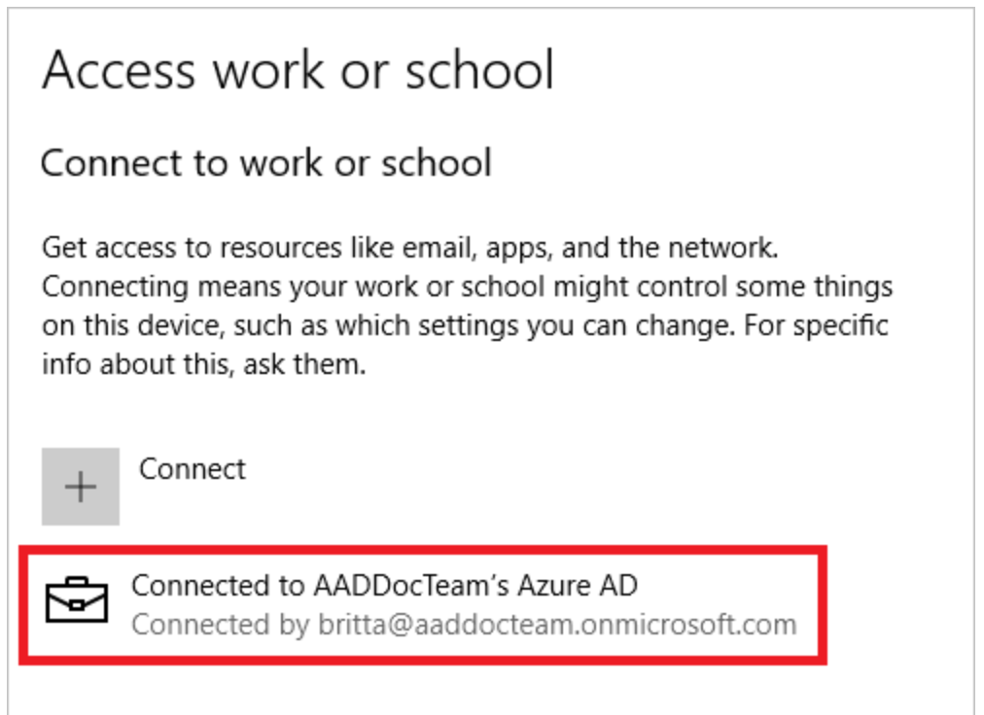
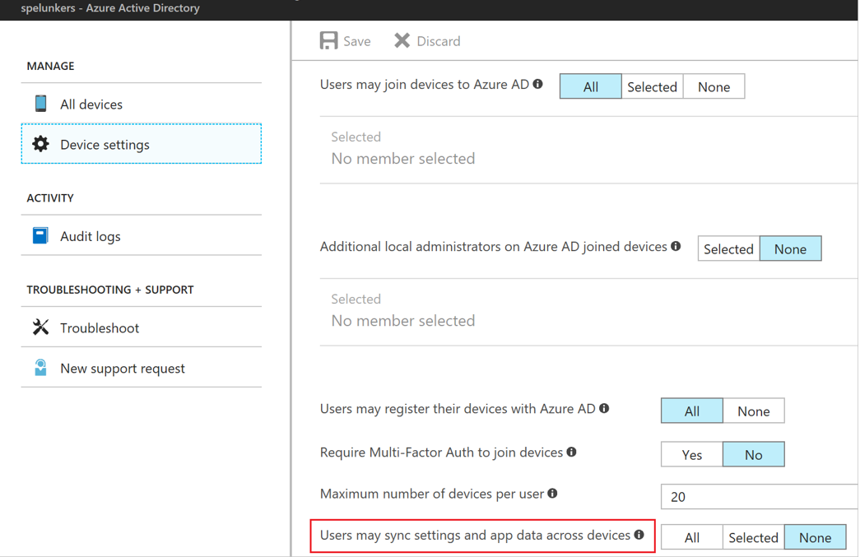
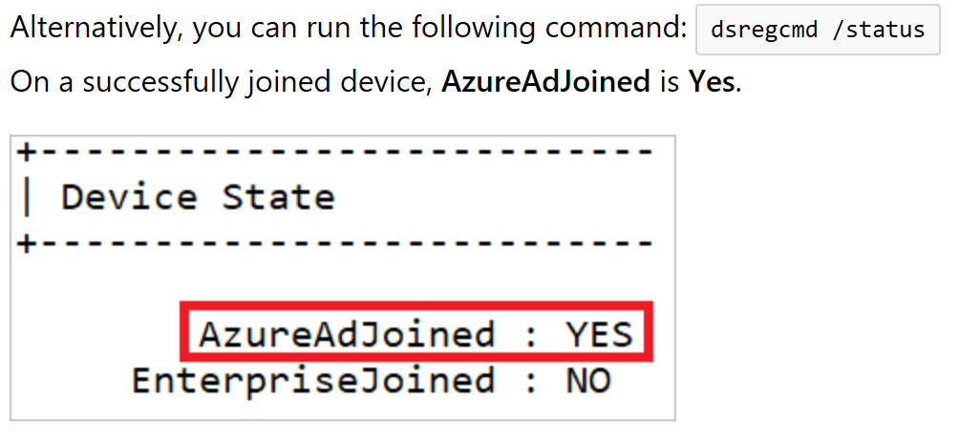
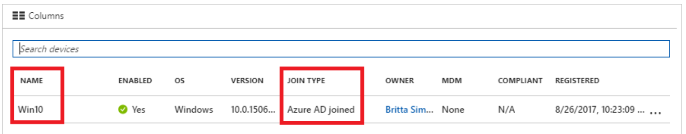
Manage Azure Active Directory (AD)
Azure AD Join
aka.ms/Azure/Roaming
Requires
  Azure AD + Subscription
  Windows 10 (Pro/Ent)
Admin Tasks
  See picture ->
User Tasks
  Register Windows 10 Device – BYOD
  Join Corp Device
    Settings, Account, Access Work or School
Verify

Slide 56
Manage Azure Active Directory (AD)
Enterprise State Roaming
Requires
  Azure AD Premium
  Windows 10
  Azure AD Domain Join
Other Notables
  3 regions: NA, EMEA, APAC
  Not replicated across
  Country/Region set on attribute
    Cannot be changed after!
Retention
  Retained until deleted or becomes “Stale”
aka.ms/Azure/Roaming

Slide 57





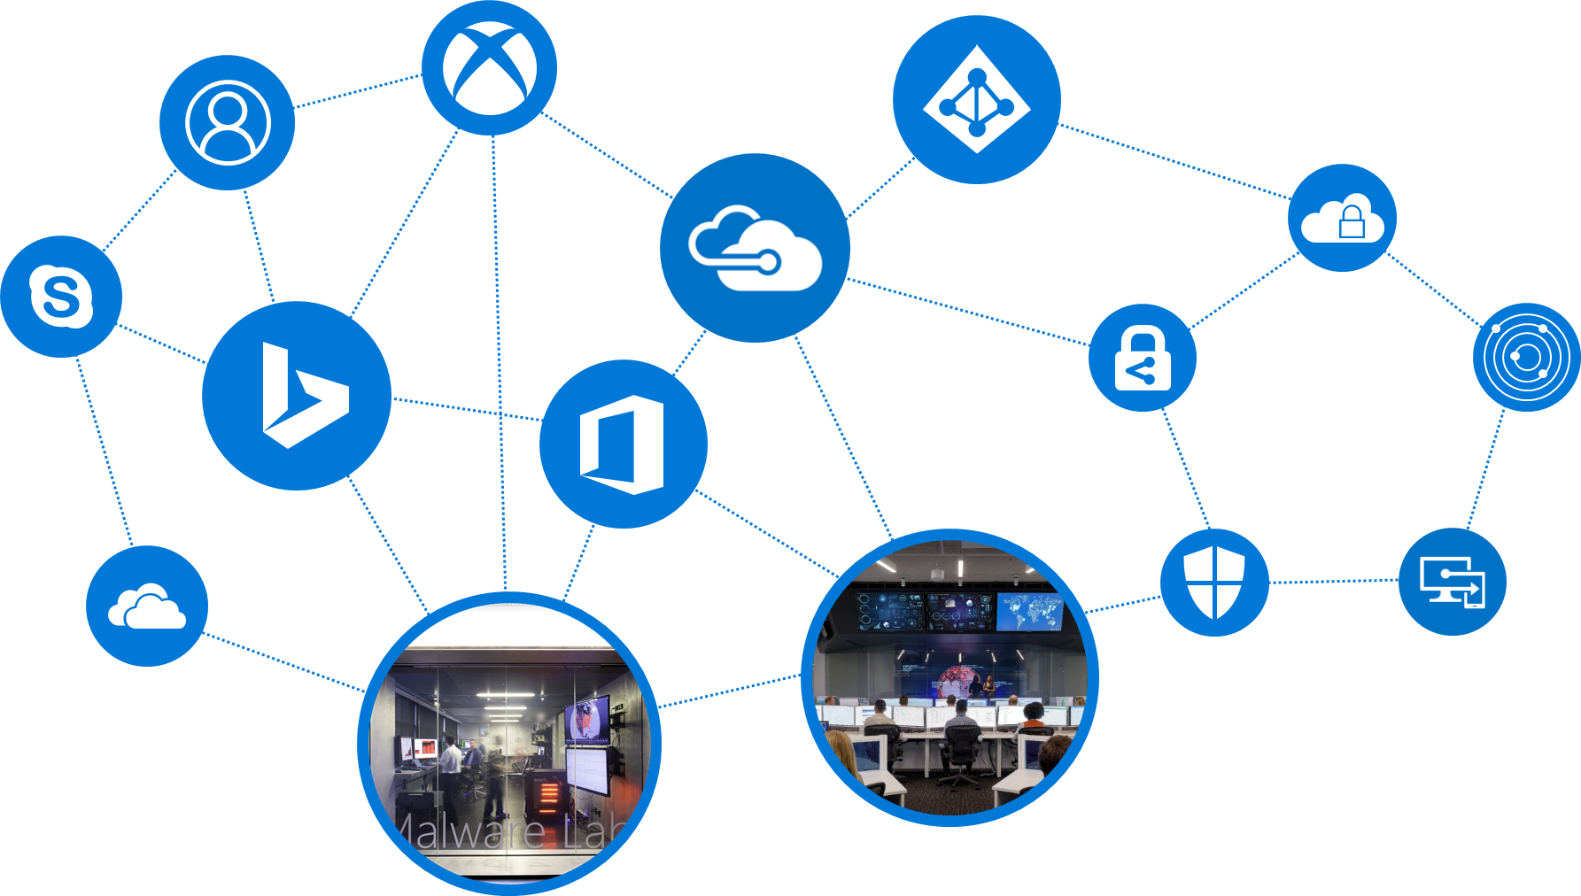
Manage Azure Active Directory (AD)
Conditional Access
Identity Protection
Multi-Factor Authentication
Providing conditional access control to APIs+ applications
  With "What if" capabilities
  Integrating behavior-based threat analytics via risk-based policies against suspicious logins and compromised credentials
USER ATTRIBUTES
User identity
Roles and group memberships
Authentication strength/context
Applications & APIS
in some clouds or elsewhere
Controls
Azure AD MFA
DEVICE
Registration state
Health state and policy compliancy
Platform type
Lost or stolen
Allow Access
Enforce multifactor authentication
LOCATION
IP range
Force password Reset
CONDITIONS
*****
APPLICATION
Application policy
Client type (native, web)
Block Access
Other
Risk profile
Terms of Use
Time
Limit access
10 To
par jour
Identity protection

Slide 58
Manage Azure AD Objects (Users, Groups, and Devices) perform bulk user updates
PowerShell
  Import a CSV
  Export from HR or SQL
Process
  Connect-AzureAD (MSonline still works, mainly used for Office 365 integration)
  Define Variables

Slide 59
Implement and Manage Hybrid Identities: 4 Scenarios
Cloud-only
  Users and Groups are managed in Azure Active Directory only
  Azure AD stores the password (encrypted)
Hybrid Active Directory with password Sync
  On-premises Active Directory is the « master »
  Users and Groups are synchronized to Azure Active Directory using ADConnect (or MIM or 3rd party)
  Password is synced encrypted out of ADConnect (or MIM or 3rd party)
Hybrid Active Directory with Federation
  Relies on ADConnect to synchronize objects
  ADFS or 3rd party Federation engine, running on-premises or in Azure VMs (with S2S or ER)
Hybrid Active Directory with PassThrough Authentication
  Relies on ADConnect to synchronize objects
  Instead of ADFS federation, deploy the PTA agents on on-premises servers (ADDS DCs)

Slide 60
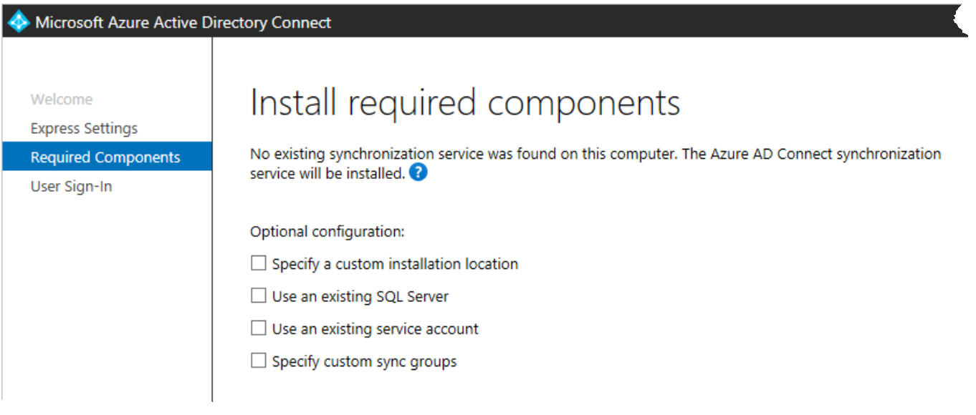
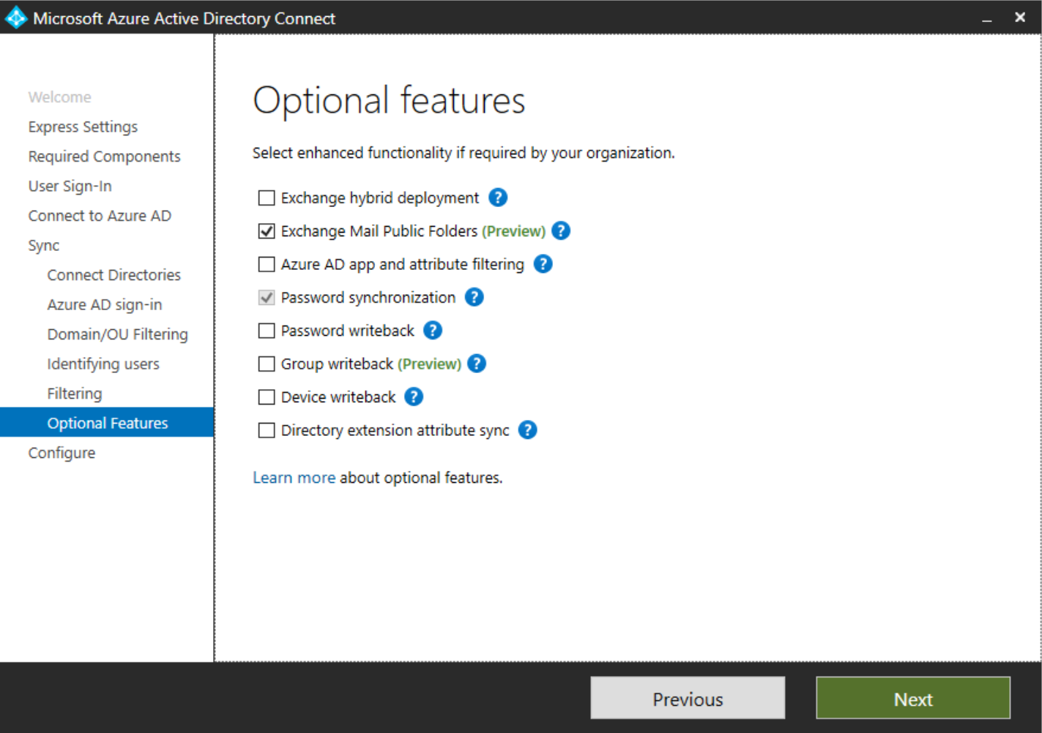
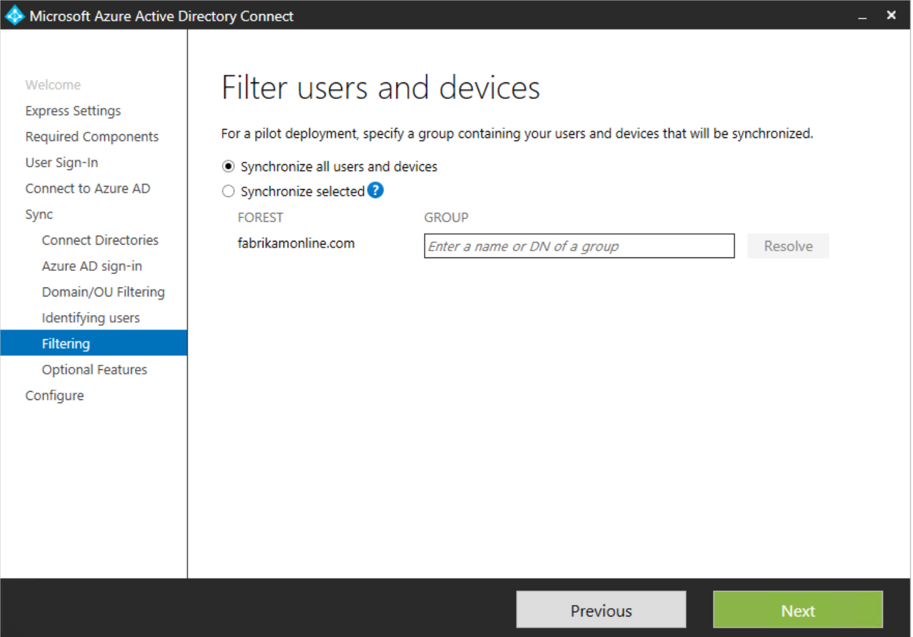
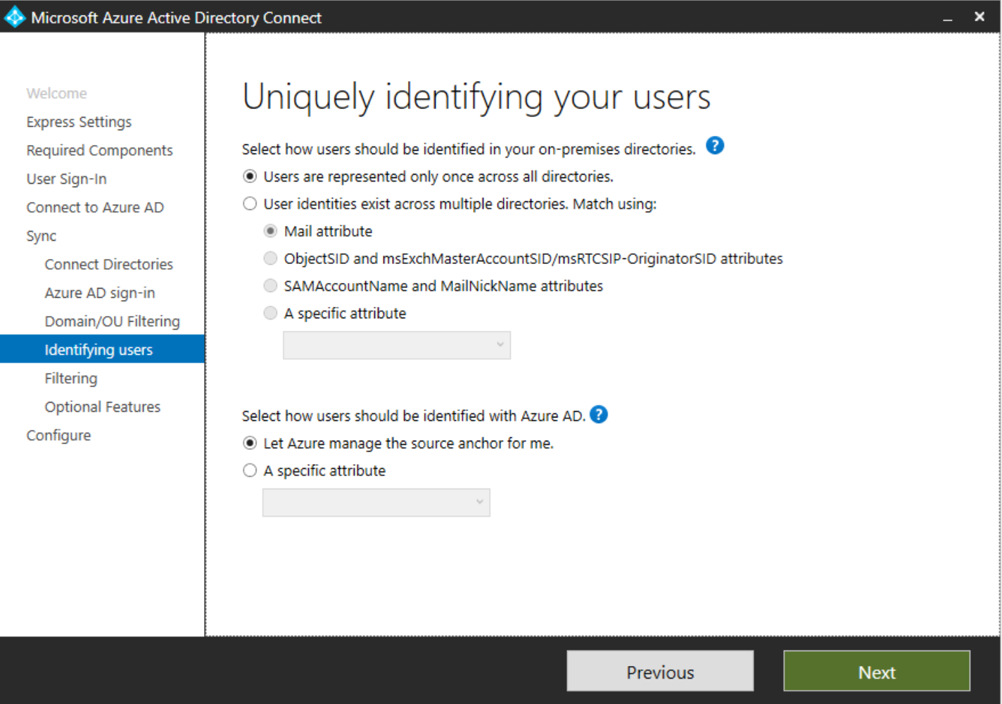
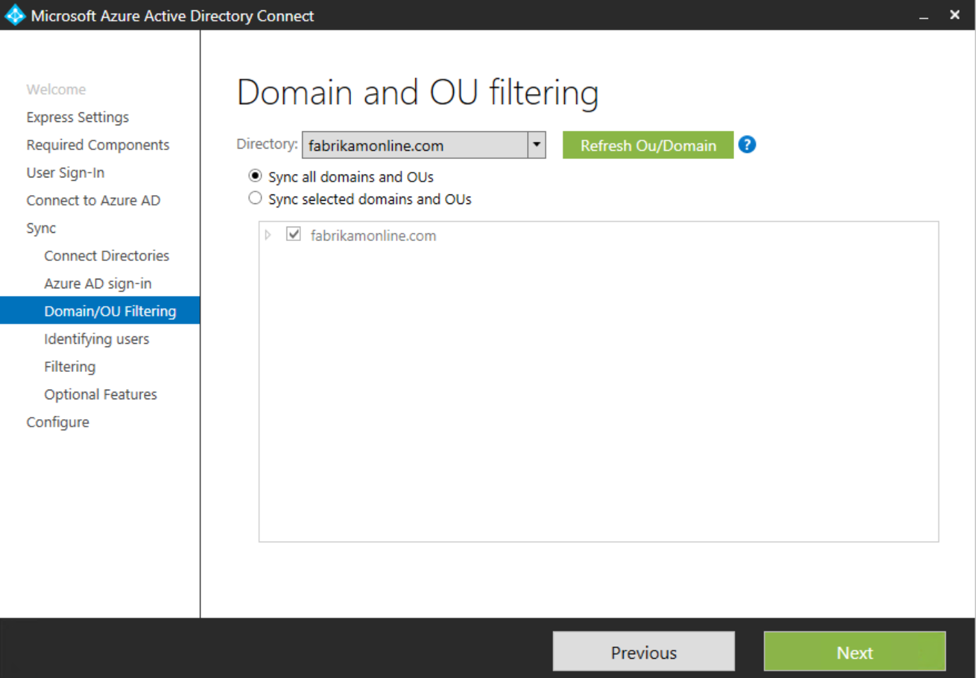
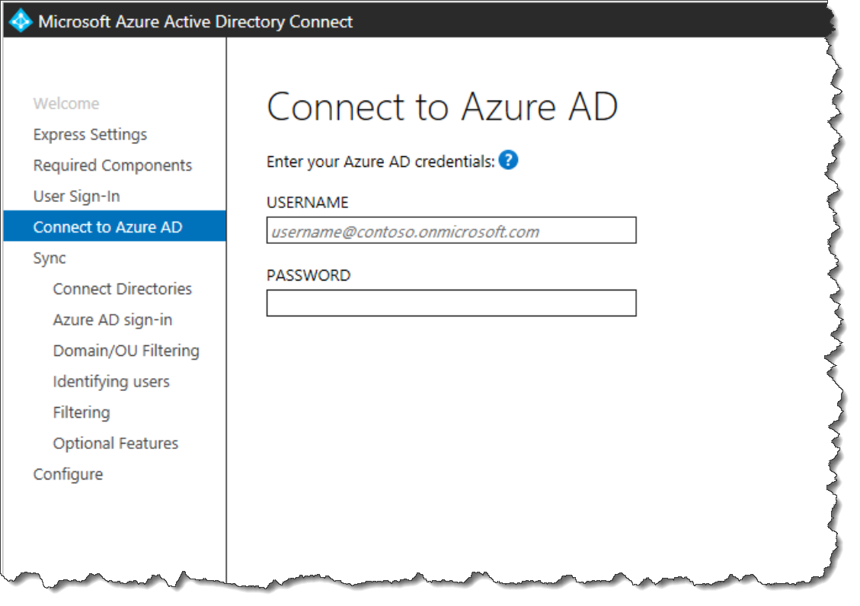
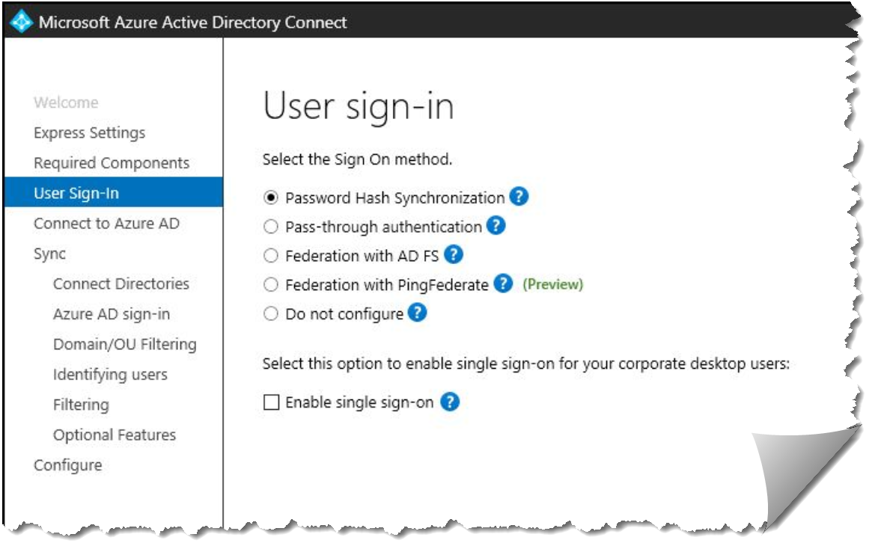
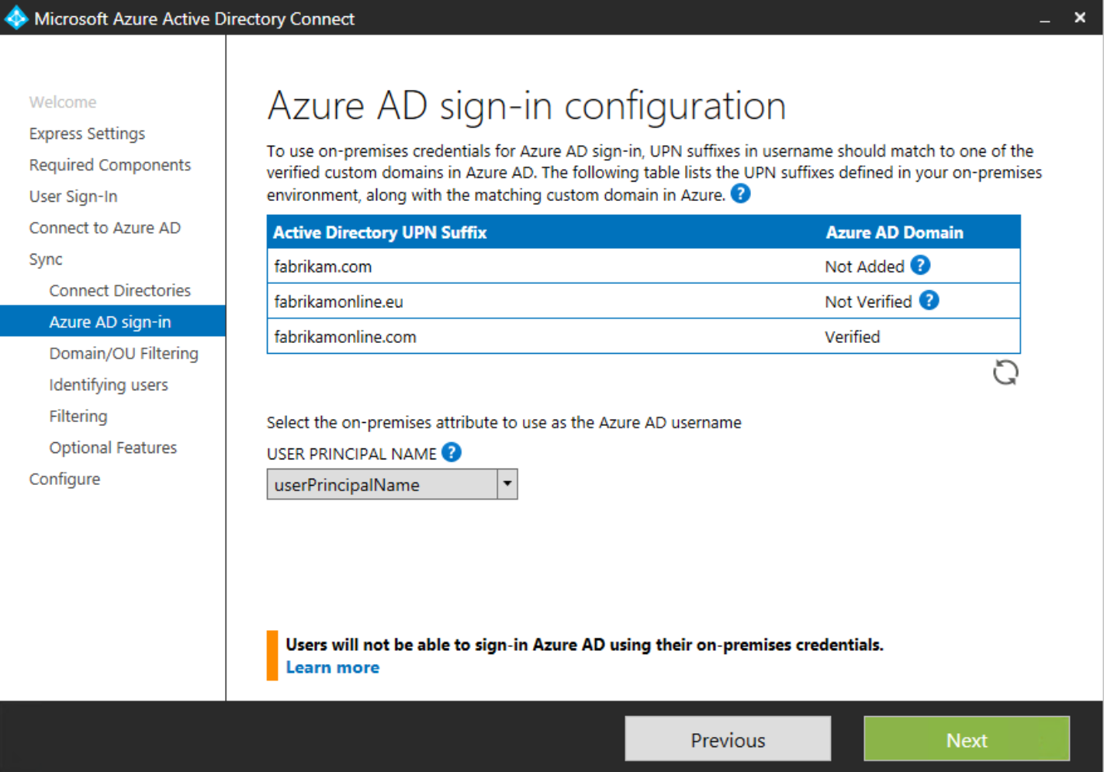
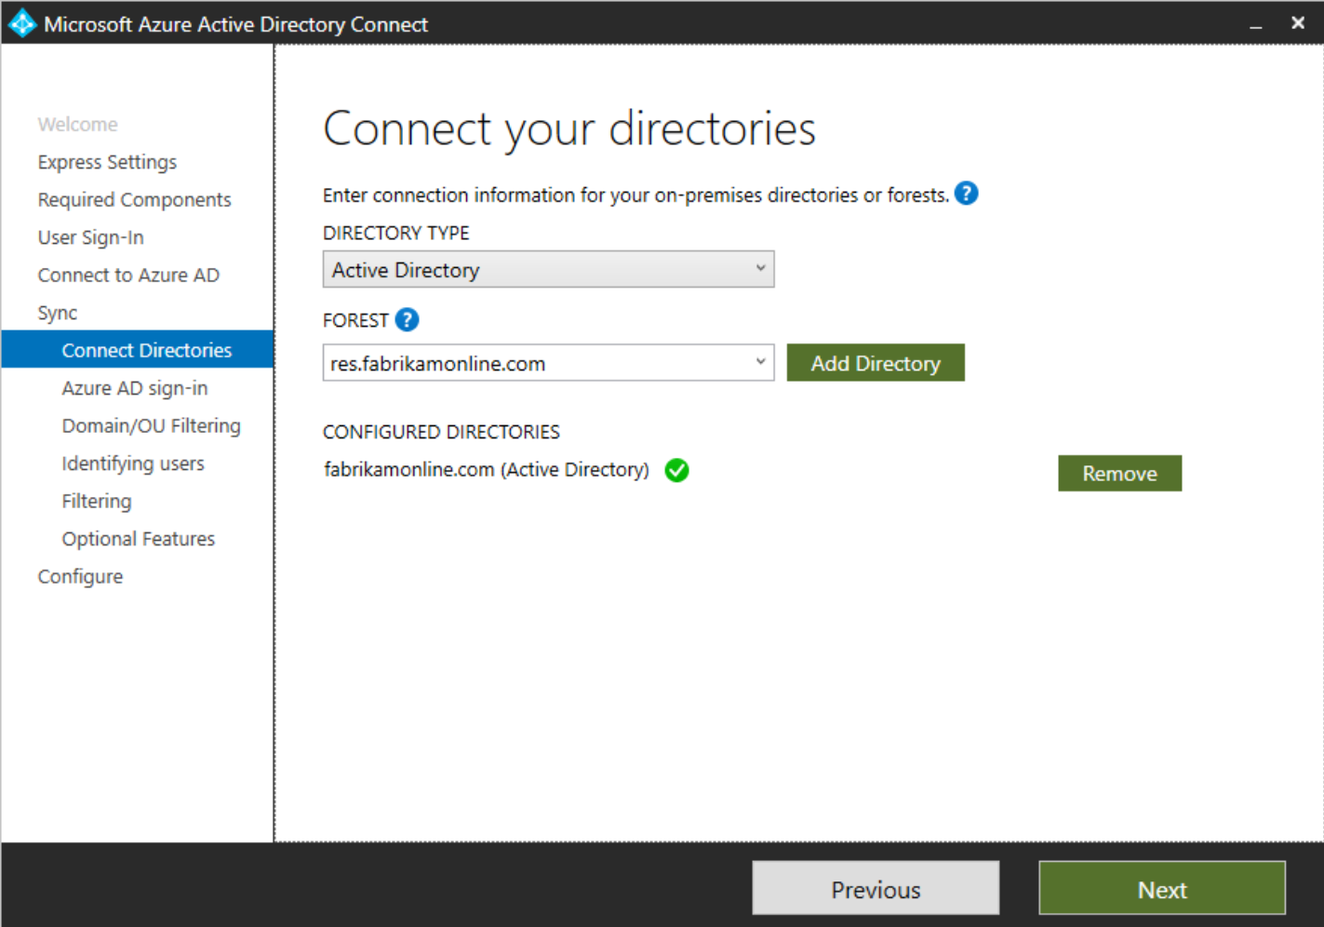
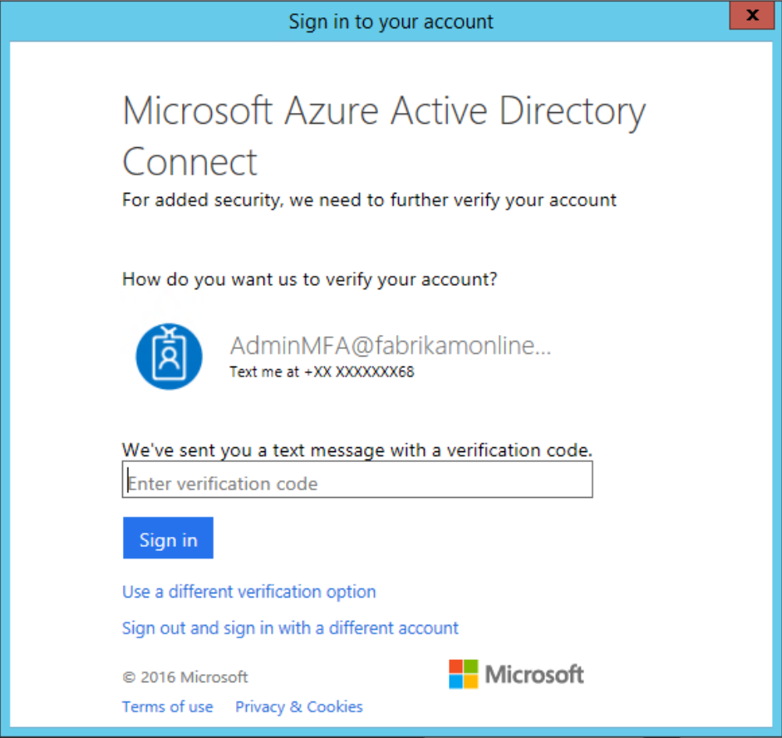
Implement and Manage Hybrid Identities
Install and configure Azure AD Connect
aka.ms/Azure/AD/Connect
Much more in here!!!!

Slide 61
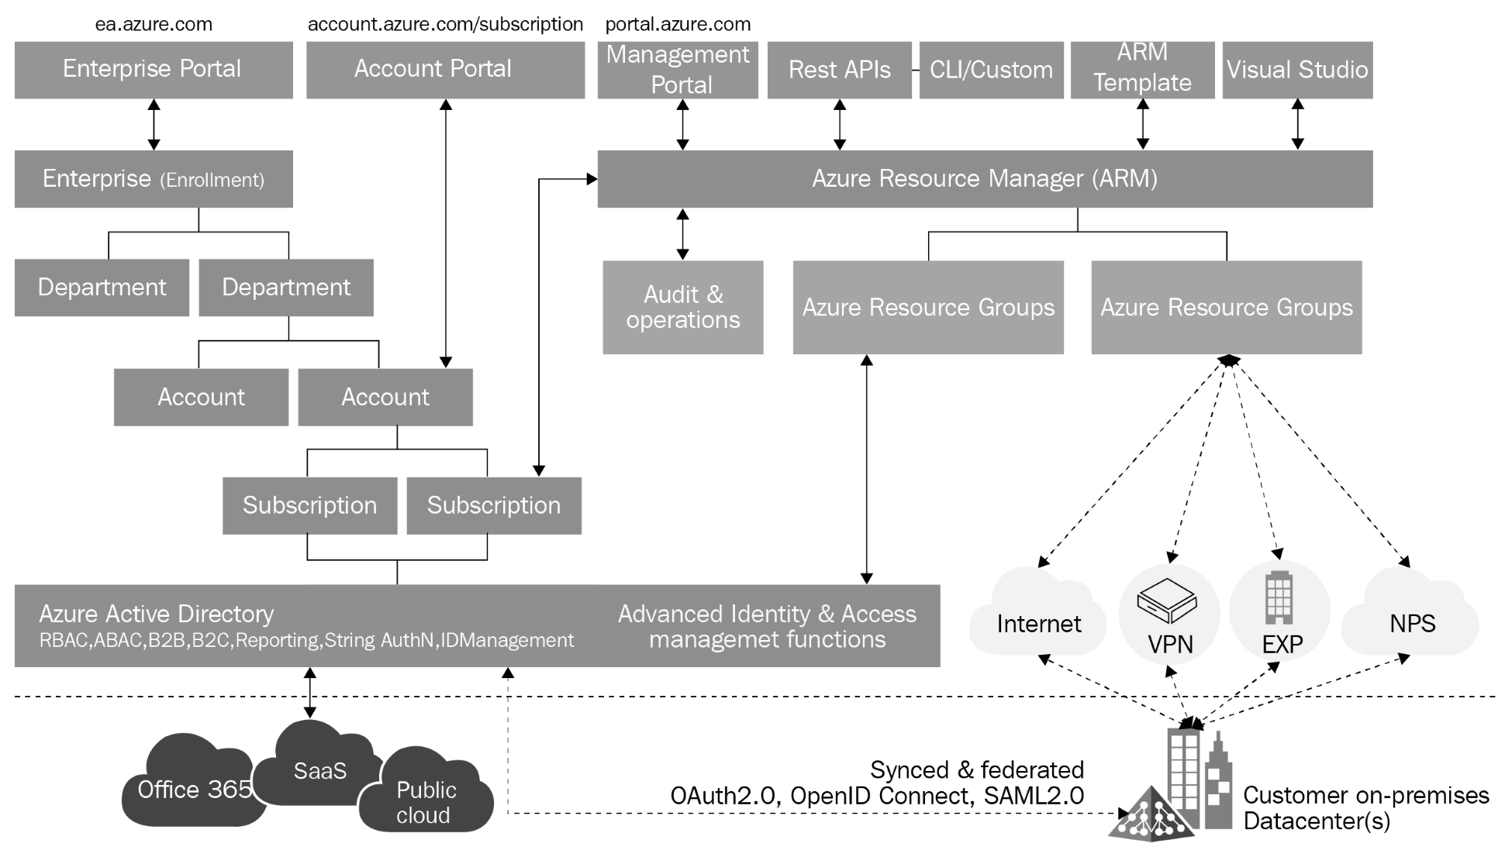
How to prepare

Slide 62
How to prepare

Slide 63

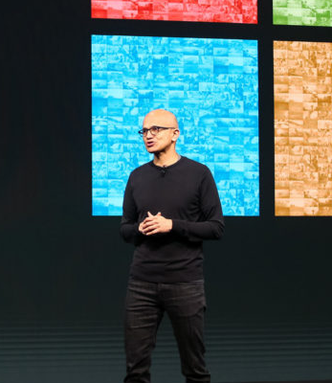

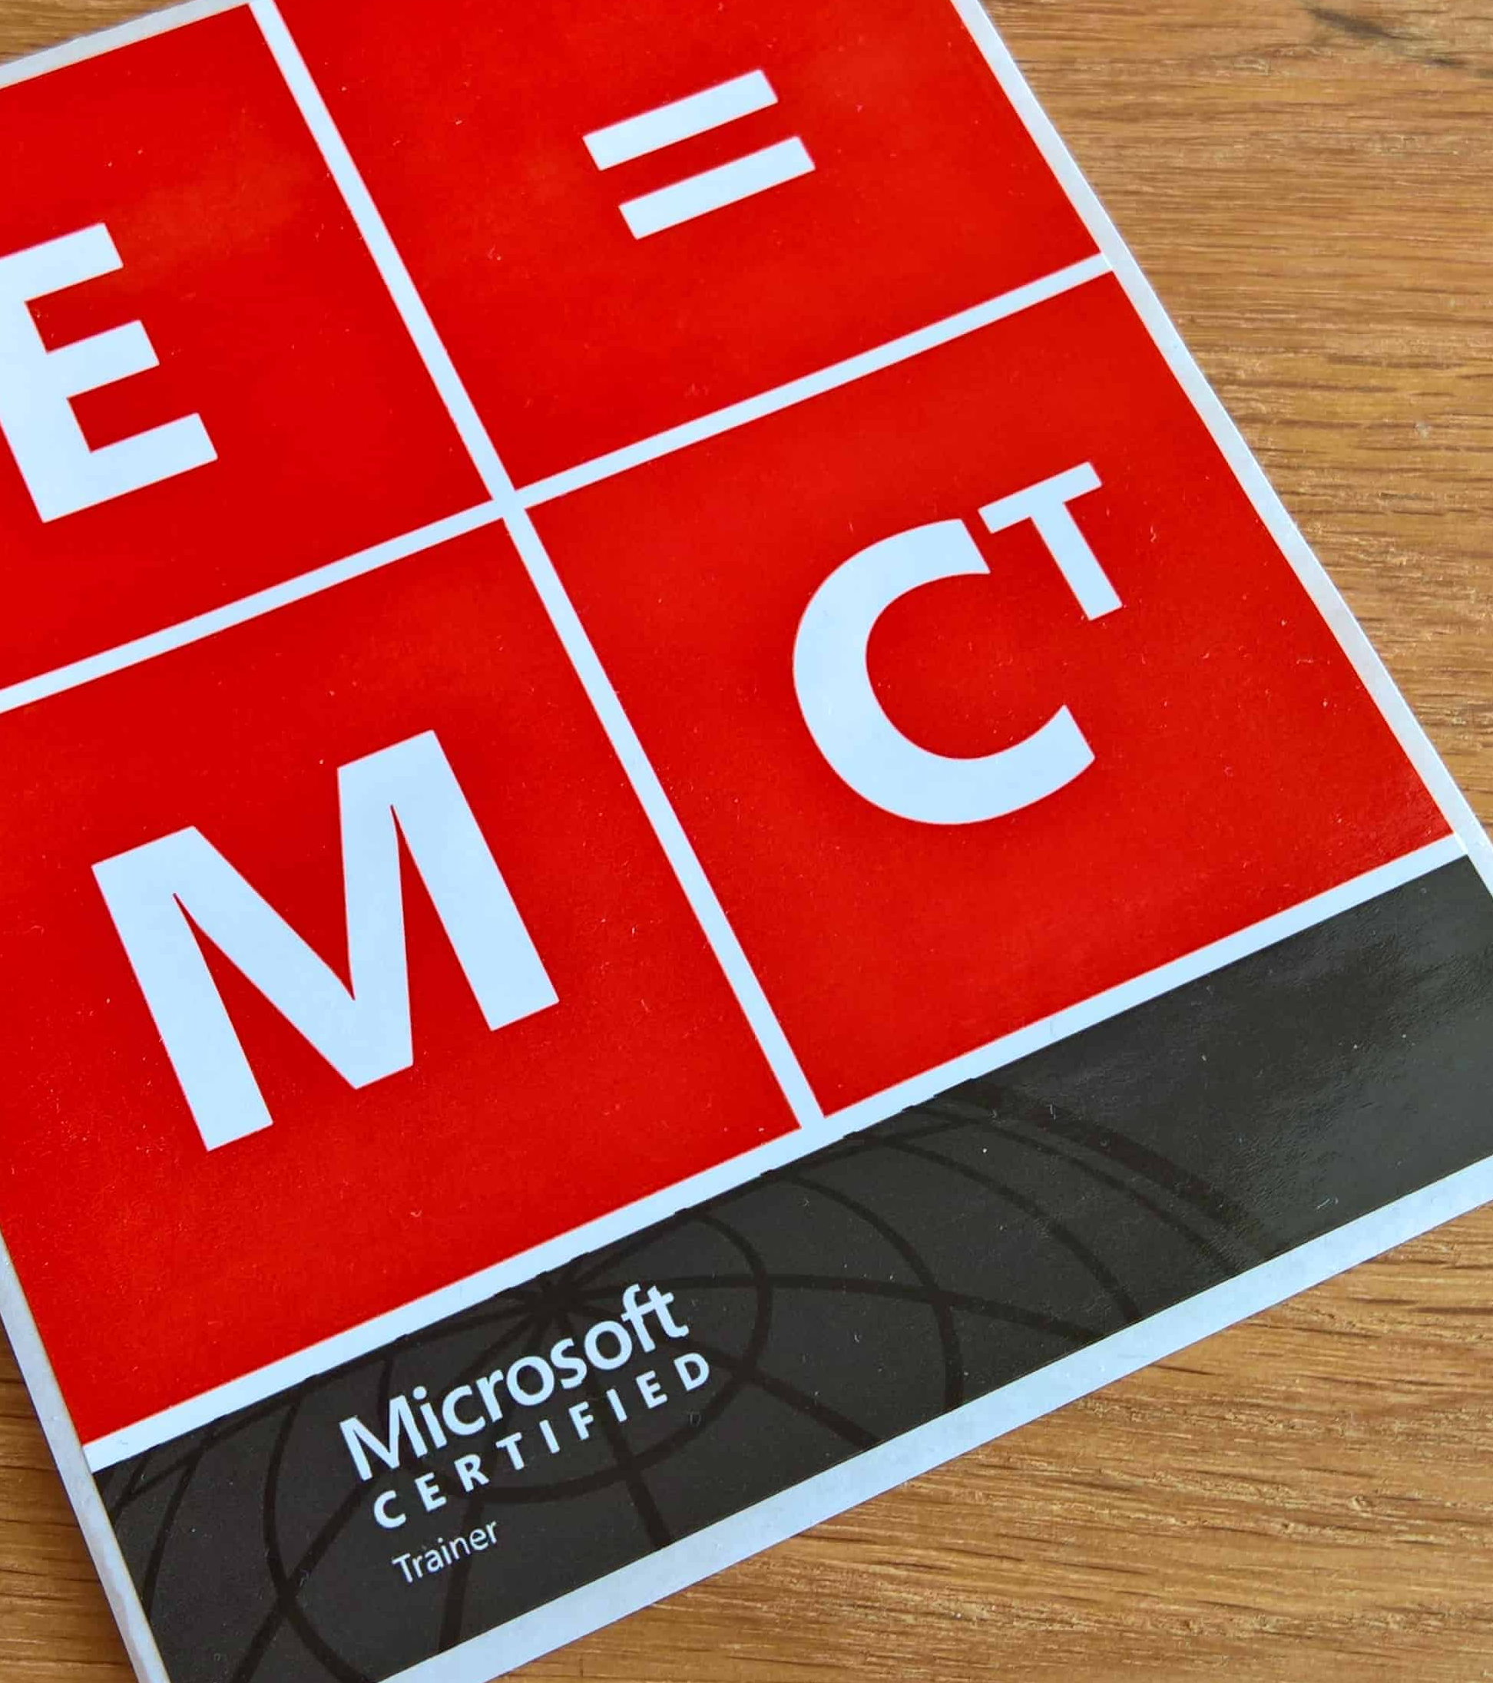
Aligned learning experiences
Digital skilling
Events
Classroom
Certifications
Build practical job skills
with easily accessible, free,
self-paced courses
Choose from
workshops, conferences,
and other events
Attend in-depth training taught by Microsoft
Certified Trainers
Validate skills with
fundamentals, role-based, and specialty certifications
Microsoft Learn
Training Events
Microsoft Official Courses (instructor-led training)
Microsoft Certification

Slide 64
Ways to prepare for certification
docs.microsoft.com/learn/certifications/exams/az-103
Exam page
Find out exam details – skills measured, training options, and schedule your exam
Microsoft Learn
Build practical job skills with easily accessible, free, self-paced courses
Classroom training
Attend in-depth training taught by Microsoft Certified Trainers
Practice tests
Practice the certification exam in either a study mode or timed testing mode

Slide 65
Tips and Tricks
What is your methodology of study?
Mind Map
Study Plan
Videos
Pratice
Simulate
Clarify
Path
Content
Concept
Knowledge

Slide 66
Attend Exam Prep sessions available this week
Session Title | Presenter | Code
Microsoft Certification 101 | Sudarshan Krishnamurthi | BRK1053
Exam Prep | AI-100: Designing and Implementing an Azure AI Solution | Glenn Morris | BRK3197
Exam Prep | AZ-103: Microsoft Azure Administrator | Josue Vidal | BRK3201
Exam Prep | AZ-203: Developing Solutions for Microsoft Azure | Mike Pfeiffer | BRK1046
Exam Prep | AZ-300: Microsoft Azure Architect Technologies | Tiago Costa | BRK3200
Exam Prep | AZ-301 Microsoft Azure Architect Design | Tim Warner | BRK3276
Exam Prep | AZ-400: Microsoft Azure DevOps Solutions | Dwight Goins | BRK4012
Exam Prep | AZ-500: Microsoft Azure Security Technologies | Gareth Jones | BRK3277
Exam Prep | AZ-900: Microsoft Azure Fundamentals | Tim Warner | BRK1047
Exam Prep | DP-100: Designing and Implementing a Data Science Solution on Azure | Glenn Morris | BRK1050
Exam Prep | DP-200: Implementing an Azure Data Solution | Dwight Goins | BRK1051
Exam Prep | DP-201: Designing an Azure Data Solution | Armando Lacerda | BRK2155
Exam Prep | MB-200: Microsoft Power Platform + Dynamics 365 Core | Julian Sharp | BRK2156
Exam Prep | MB-900: Microsoft Dynamics 365 Fundamentals | Sarah Jelenik | BRK1102
Exam Prep | MD-100: Windows 10 | Andrew Bettany | BRK2154
Exam Prep | MS-100: Microsoft 365 Identity and Services | Ed Baker | BRK2157
Exam Prep | MS-101: Microsoft 365 Mobility and Security | Ed Baker | BRK1052
Exam Prep | MS-700: Managing Microsoft Teams | Jenny Chen | BRK1106
Exam Prep | MS-900: Microsoft 365 Fundamentals | Mark O'Shea | BRK1048

Slide 67
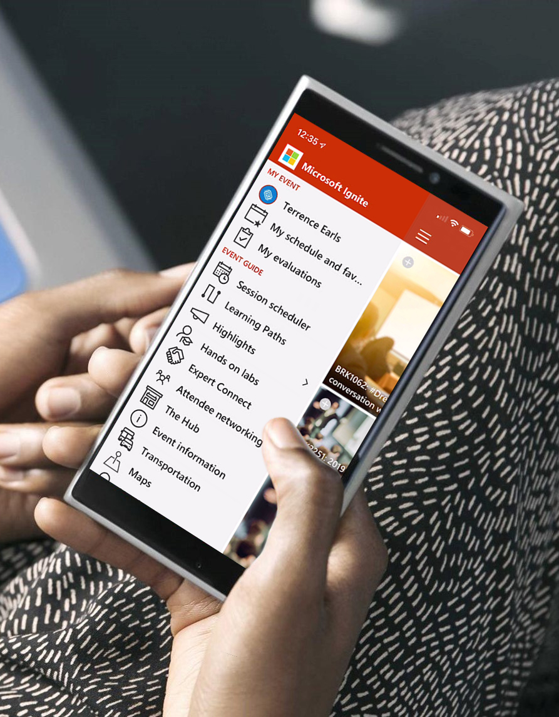
Please evaluate this session
Your feedback is important to us!
Please evaluate this session through MyEvaluations on the mobile app or website.
Download the app:
https://aka.ms/ignite.mobileapp
Go to the website:
https://myignite.techcommunity.microsoft.com/evaluations

Slide 68
Visit aka.ms/MicrosoftIgnite2019/BRK3201
Download slides and resources
Access session recordings in 48 hours
Ask questions & continue the conversation
Find this session in Microsoft Tech Community

