Slide 1
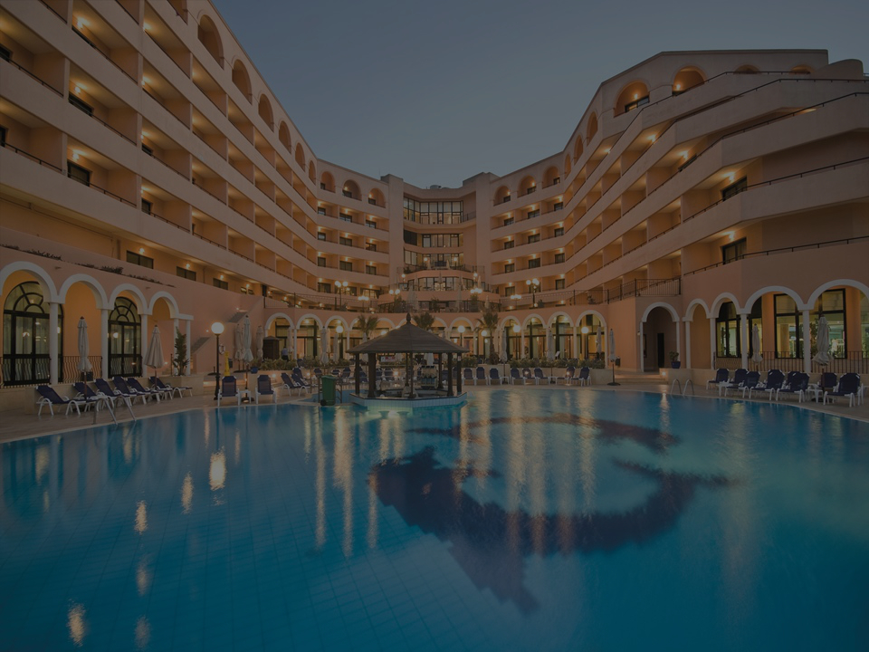
Luxury Hotel Software System
Enter Password
Notes:
Password must be entered to access the system. The ellipses provides help associated with the logon process, such as a password reset. The Flow: User enters password, [PROCESSING…] appears. IF password is valid THEN the Main Menu appears ELSE password is bad a notification popup alerts user of: “INVALID PASSWORD!” IF ellipses is selected THEN prompt for employee ID IF employee ID is valid allow password reset ELSE popup error “Not a valid employee ID”

Slide 2
Luxury Hotel Software System
[ Main Menu ]
1
2
3
4
[ Enter Option ]
Notes:
User will enter option 1, 2, 3, 4 or select [Help] if they need assistance understanding the drop-down menu options User will enter one of the options, or an error will appear. They can enter the option via the keyboard or in drop-down menu. IF option is valid THEN access menu option IF 1 GOTO Check-in Patron Menu IF 2 GOTO Check-out Patron Menu IF 3 GOTO Reservations Menu IF 4 GOTO Logout Display “Are you sure you want to logout?” IF yes THEN log out of system IF no THEN return ELSE Display alert “Invalid Option! Valid options are 1, 2, 3, 4”

Slide 3
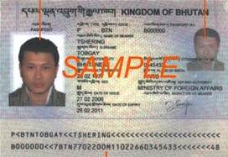
Luxury Hotel Software System
[ Check-in Menu ]
Patron Last Name
How many rooms
Check-in Date
Patron First Name
Room Size
Check-out Date
How many adults
Room Number
Balance
How many children
Scan Passport/License
Notes:
User must enter relative information into each field. If they need help, there is a [Help] button explaining the items on this page. [Cancel] The user may also select cancel at any time. If [Cancel] is selected, user will receive a notification
Saying “Are you sure?” If yes, go back to Main Menu. If no, return to current page. [Patron Last Name] must be entered, or a notification message will popup saying “Field cannot be empty” User will type the name via the keyboard. [Patron First Name] must be entered, or a notification message will popup saying “Field cannot be empty” User will type the name via the keyboard. [How many adults] and/or [How many children] must be entered, even if it 0, otherwise a message will popup saying “ Enter valid option: 0-200” 200 is the maximum occupancy at this hotel. User can either enter the numbers via the keyboard or select the number via the arrows. Note, both adult AND children cannot be [0]; there must be at least 1 or more occupants or a message will appear “Occupants cannot be 0” [How many rooms] must have a valid number of at least 1, otherwise a message will popup saying “Enter a valid room number: 1-150.” There are 150 total rooms at this hotel. User can either enter the number via the keyboard or select the number via the arrows. [Room Size] has 5 available options: [1-full], [2-double], [3-queen], [4-king], [5-honeymoon suite] User must enter a valid option, otherwise a message will appear saying “Please select the room size 1-5” [Scan Passport/License] – To maintain the highest level of security for our patrons, we have implemented an identification scanner. This is not optional. Patron must have a valid passport or license to be scanned into the system. If this item is skipped, when user presses the Check-in button it will alert user “Please scan patron identification” If this cannot be done for some reason, there will be a manager override feature. The manager will have to be present to complete check-in. [Check-in] and [Check-out] dates must be specified, even if they change some time after data entry. User can either enter a date in the field; it must be mm/dd/yyyy, otherwise user will receive a popup “Please enter date as mm/dd/yyyy” User will also have the option to select a date directly from a calendar popup via the arrows. Finally, once all information has been properly entered, the user can press the [Check-in] button, a PROCESSING… message will popup. If there are no problems, a CHECK-IN COMPLETED message appears and the balance can be seen in the balance field. If there are problems in processing, a message will appear saying “PLEASE TRY AGAIN. INFORMATION WAS NOT SAVED!” If user continues to have problems (after 5 tries), a message will appear alerting user to switch to Manual Check-in (our paper method) and to contact the manager immediately. Once the balance appears, the patron can either pay now, some or all of the balance, or wait until checkout. If they want to make a payment now, the user selects the [Make Payment] button and accepts cash or credit. A PROCESSING… message appears. If the funds are accepted, a TRANSACTION COMPLETED message appears. If the funds are not accepted, a TRANSACTION FAILED message appears. When check-in has been completed, the [Main Menu] and [Print] buttons can be accessed. The Main Menu is not accessible until check-in has been completed, or the Cancel button has been selected. When check-in has been completed, the [Print] button may also be accessed. [Print] The user has the ability to print this information if requested, or for administrative purposes. If the [Print] button is selected, a PROCESSING PRINT JOB message will appear. If successful, a PRINTING COMPLETE message will appear. If printing failed, a PRINT JOB FAILED message will appear. [Main Menu] Returns user back to the Main Menu. It is important to note that this area can also be used to update information, such as if [Check-out Date], occupants, [Room Number] changes, etc.

Slide 4
Luxury Hotel Software System
[ Check-out Patron Menu ]
Patron Last Name
Room Number
Check-in Date
Patron First Name
Check-out Date
Balance
Passport/License
Notes:
[Help] If the user needs help, there is a [Help] button explaining the items on this page. [Cancel] The user may also select cancel at any time. If [Cancel] is selected, user will receive a notification
Saying “Are you sure?” If yes, go back to Main Menu. If no, return to current page. During [Check-out], user can identify a patron quickly by entering their name or room number. Once the patron’s information appears, user will verify via the scanned identification that this is the correct patron. The first name and/or last name will be typed with the keyboard. A valid name must be entered, or message will return “PATRON NOT FOUND. TRY AGAIN.” The user may also use a [Room Number] to bring up the patron’s information. The number can be entered via the keyboard or with the arrows. If entered with the keyboard, the number must be 1-150, otherwise a popup message will appear “Enter a valid room number: 1-150” If this is the correct patron, user will continue the check-out process. If not, user must check the name and/or room number again. [Check-in Date] will be the original check-in date; it will already be in the check-in date field. [Check-out Date] will be carried over from the original data entry, however may be adjusted to current date. Date can either be entered in via keyboard or arrows. If by keyboard, date must adhere to the mm/dd/yyyy, or user will receive a popup message, “Please enter date as mm/dd/yyyy” At this point, the patron must pay the balance if there is one. The user selects the [Make Payment] button and accepts cash or credit. A PROCESSING… message appears. If the funds are accepted, a TRANSACTION COMPLETED message appears. If the funds are not accepted, a TRANSACTION FAILED message appears. Once the transaction is complete, the balance will go to $0, and a message will appear CHECK-OUT COMPLETED. When Check-out has been completed, the [Main Menu] and [Print] buttons can be accessed. [Print] The user has the ability to print this information if requested, or for administrative purposes. If the [Print] button is selected, a PROCESSING PRINT JOB message will appear. If successful, a PRINTING COMPLETE message will appear. If printing failed, a PRINT JOB FAILED message will appear. [Main Menu] Returns user back to the Main Menu.

Slide 5
Luxury Hotel Software System
[ Reservation Menu ]
Patron Last Name
How many rooms
Check-in Date
Patron First Name
Room Size
Check-out Date
How many adults
Room Number
Confirmation Number
How many children
Notes:
[Help] If the user needs help, there is a [Help] button explaining the items on this page. [Cancel] The user may also select cancel at any time. If [Cancel] is selected, user will receive a notification
Saying “Are you sure?” If yes, go back to Main Menu. If no, return to current page. [Patron Last Name] must be entered, or a notification message will popup saying “Field cannot be empty” User will type the name via the keyboard. [Patron First Name] must be entered, or a notification message will popup saying “Field cannot be empty” User will type the name via the keyboard. [How many adults] and/or [How many children] must be entered, even if it 0, otherwise a message will popup saying “ Enter valid option: 0-200” 200 is the maximum occupancy at this hotel. User can either enter the numbers via the keyboard or select the number via the arrows. Note, both adult AND children cannot be [0]; there must be at least 1 or more occupants or a message will appear “Occupants cannot be 0” [How many rooms] must have a valid number of at least 1, otherwise a message will popup saying “Enter a valid room number: 1-150.” There are 150 total rooms at this hotel. User can either enter the number via the keyboard or select the number via the arrows. [Room Size] has 5 available options: [1-full], [2-double], [3-queen], [4-king], [5-honeymoon suite] User must enter a valid option, otherwise a message will appear saying “Please select the room size 1-5” [Check-in] and [Check-out] dates must be specified, even if they change some time after data entry. User can either enter a date in the field; it must be mm/dd/yyyy, otherwise user will receive a popup “Please enter date as mm/dd/yyyy” User will also have the option to select a date directly from a calendar popup via the arrows. [Credit Card] Once all information has been properly entered, the user will enter the patron’s credit card number to reserve the room. This is not optional. To reserve a room, the patron must have a valid credit card. If this information is not entered, a message will appear “Please enter valid credit card to complete reservation” When the credit card information has been entered, a PROCESSING… message will appear. If the credit card is good, a PROCESSING COMPLETED SUCCESFULLY message will appear. The [Reserve] button can be selected at this time. [Reserve] When the reserve button is selected, a PROCESSING… message will popup. If there are no problems with all the entered data (and no system or technical issues), a RESERVATION COMPLETED message appears and the [Confirmation Number] is displayed; the confirmation number will be given to the patron. If there are problems in processing, a message will appear saying “PLEASE TRY AGAIN. INFORMATION WAS NOT SAVED!” If user continues to have problems (after 5 tries), a message will appear alerting user to switch to Manual Reservation (our paper method) and to contact the manager immediately. When the reservation has been completed, the [Main Menu] and [Print] buttons can be accessed. The Main Menu is not accessible until the reservation has been completed, or the Cancel button has been selected. [Print] When reservation has been completed, the [Print] button may also be accessed. The user has the ability to print this information if requested, or for administrative purposes. If the [Print] button is selected, a PROCESSING PRINT JOB message will appear. If successful, a PRINTING COMPLETE message will appear. If printing failed, a PRINT JOB FAILED message will appear. [Main Menu] Returns user back to the Main Menu. It is important to note that this area can also be used to update information, such as if [Check-in Date], [Check-out Date], occupants, Credit Card reserve information, or [Room Number] changes, etc.

Slide 6
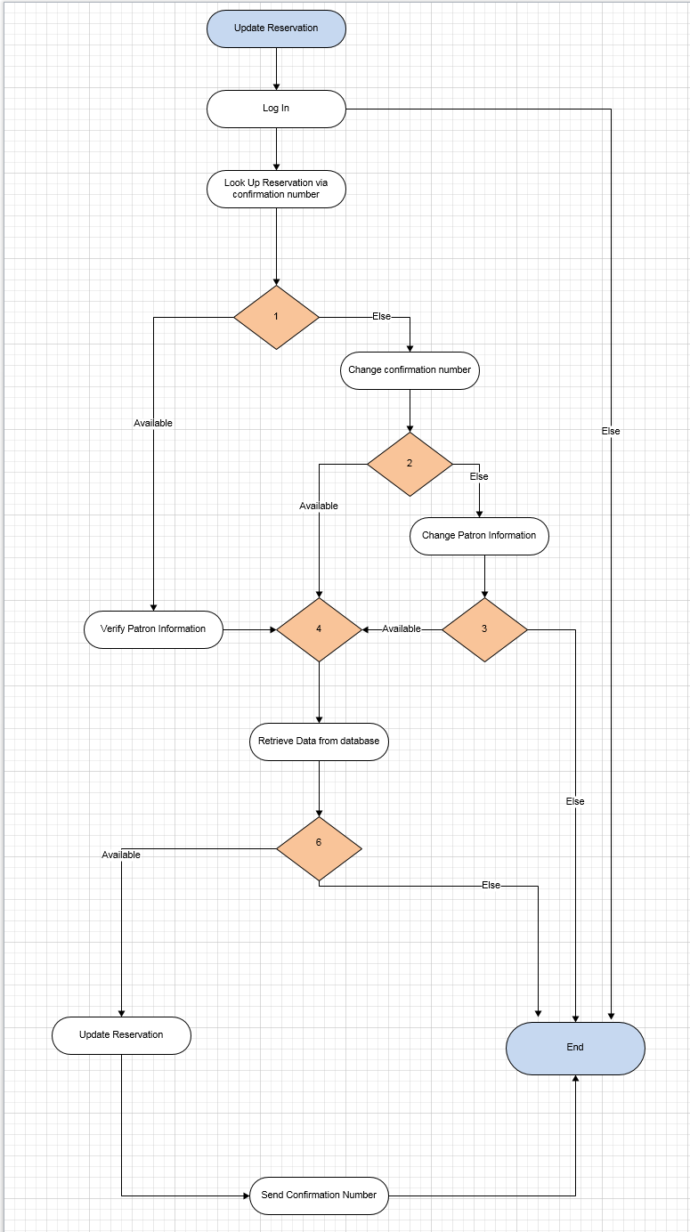
Notes:
See attached for Visio diagram.

